Slide 1
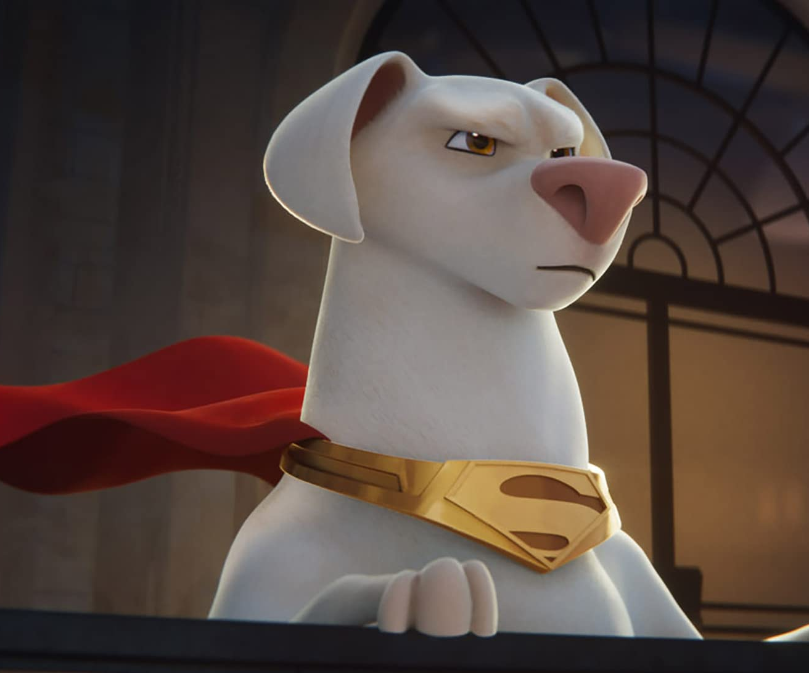
DC League of Super-pets
A
Release Date
20 May
Cast
Dwayne Johnson, Kevin Hart, Keanu Reeves
Director
Jared Stern, Sam Levine (Directorial Debut)
Recommended if you like
The LEGO Batman Movie
Reasons to buy into
An incredible cast of stars lend their voices to this new animation from the artists who previously worked on The LEGO Batman Movie.
Key audience info
7-15 Kids Index:
Est. DCM admissions
1.1m
Superman’s dog teams up with a flying cat to stop crime while Superman is on vacation.
Plan your campaign

