Slide 1


BBFC BLACK CARD COMPETITION
Puss In Boots: The Last Wish.
Universal. Suitable for all.

Slide 2

BBFC BLACK CARD COMPETITION
A unique opportunity for a brand looking to engage a family audience
Give your customers and their children the chance to design the BBFC Black Card for the February 2023 release of Puss In Boots: The Last Wish.
For the recent Jurassic World Dominion release, BBFC and Universal stepped away from the traditionally plain black cards in favour of a more interesting and exciting design (pictured). This is something that they will be looking to continue for a limited number of future releases, with the first opportunity in Puss In Boots: The Last Wish.
In partnership with BBFC and Universal, your brand would present a competition to design a unique BBFC card that will feature on every edition of Puss In Boots nationwide.
The competition, targeted at school age children would be promoted in relevant family films across Q4 2022 in the run up to Puss In Boots, as well as through BBFC’s School Outreach Programme to boost engagement with school age children and encourage entries.
This is an opportunity to create an association with family film in partnership with BBFC, Universal and Puss In Boots whilst simultaneously creating opportunity, and inspiring thousands of young children (and their parents).

Slide 3
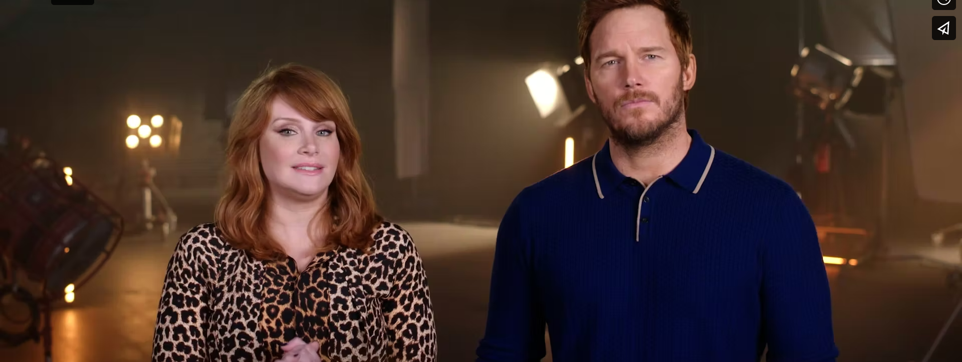
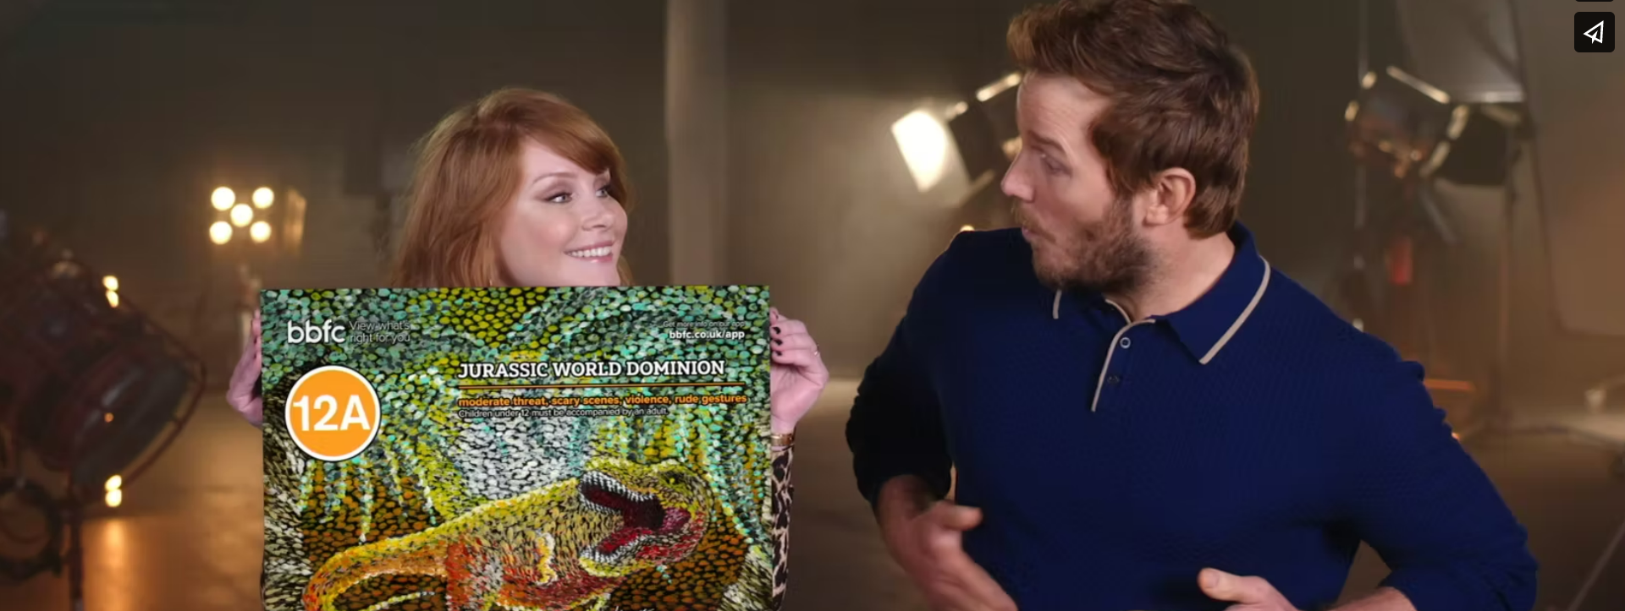
TWO PHASES TO THE CAMPAIGN
PHASE 1 - A Call for Entries
PHASE 2 - Celebrate the Winner
(Click to watch e.g. content from recent Jurassic World competition)
Bespoke content created by DCM Studios would promote the competition and encourage participation around other family releases across October-December ’22.
This would run on the big screen alongside your brand’s existing ad, as well as on digital panels in the cinema foyers to engage a family film audience.
Bespoke content would be created using existing content from Puss In Boots: The Last Wish as well as graphics and a possible VO. We are currently exploring the possibility of getting access to talent, Antonio Banderas to appear in partnership content.
The competition would also be promoted through the BBFC school outreach program to maximise participation. Alongside this it will also be amplified across BBFC and Universal social media channels and leveraged through publicity.
(Click to watch e.g. content from recent Jurassic World competition)
Celebrate the partnership and showcase the winning design before Puss In Boots: The Last Wish.
Your brand would buy in to the Gold Spot ahead of the film, the last commercial spot available before the film starts. The Gold Spot is minimum 60” in length which could be divided into 30” brand ad + 30” bespoke content unveiling the winner and reminding audiences of the competition.
Content would be created using clips from Puss In Boots: The Last Wish and would feature the winning design before it’s unveiled in all its glory at the start of the film.
Again, we would lean on BBFC and Universal’s social media accounts to celebrate the winner and encourage people to see the winning design at the cinema.

Slide 4
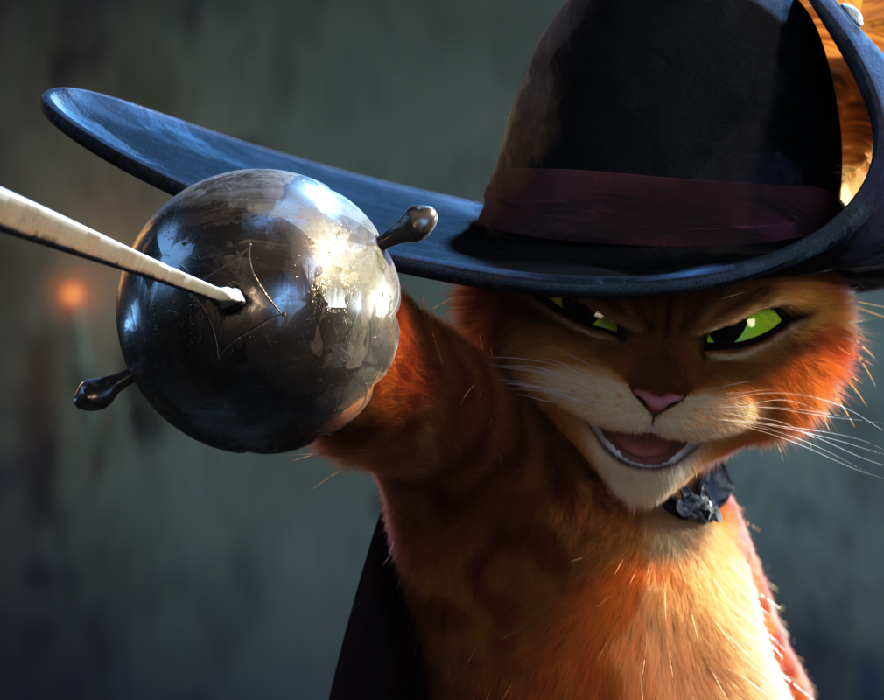

A LOOK AT THE FILM
PUSS IN BOOTS: THE LAST WISH
3rd February
Cast
Antonio Banderas, Salma Hayek
Director
Joel Crawford (The Croods: A New Age), Januel Mercado (feature debut)
Recommended if you like
Puss In Boots, Shrek
Key audience info
HW w/kids Index: 161
Est. DCM admissions
1.2m (Full DCM estate), 1.0m (excluding Independents)
The feline hero from Shrek gets his second spin-off film. Puss in Boots discovers that his passion for adventure has taken its toll: he has burned through eight of his nine lives. Puss sets out on an epic journey to find the mythical Last Wish and restore his nine lives.

Slide 5
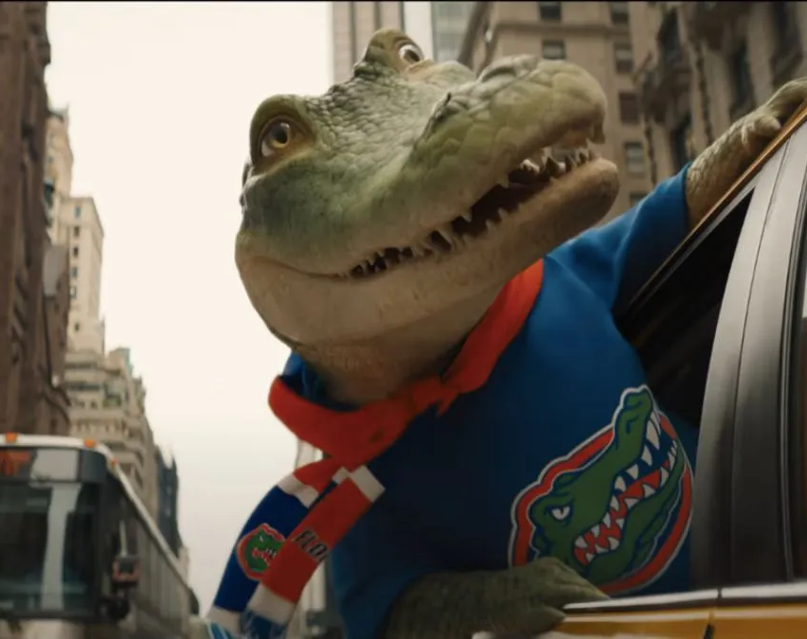
OTHER FAMILY FILMS
LYLE, LYLE CROCODILE
14th October
A family book makes a leap to the big screen
Cast
Javier Bardem, Constance Wu, Brett Gelman, Shawn Mendes
Director
Josh Gordon, Will Speck (Blades Of Glory, Office Christmas Party)
Recommended if you like
Clifford the Big Red Dog
Key audience info
Kids 7-15 Index: 334
Est. DCM admissions
1.08m
Feature film based on the children's book about a crocodile that lives in New York City.

Slide 6
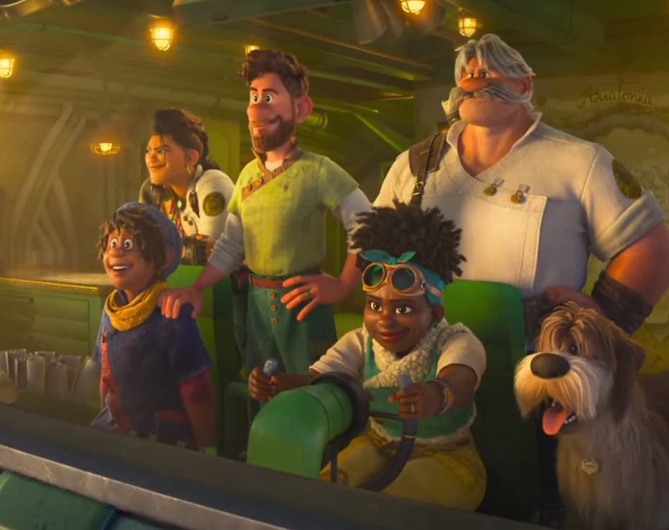
OTHER FAMILY FILMS
STRANGE WORLD
25th November
A brand-new animated Disney adventure
Cast
Jake Gyllenhaal, Alan Tudyk
Director
Don Hall (Big Hero 6, Moana, Raya And The Last Dragon)
Recommended if you like
Moana, Raya And The Last Dragon
Key audience info
7-15 Kids Index: 383
Est. DCM admissions
1.3m
The legendary Clades are a family of explorers whose differences threatened to topple their latest and most crucial mission.

Slide 7
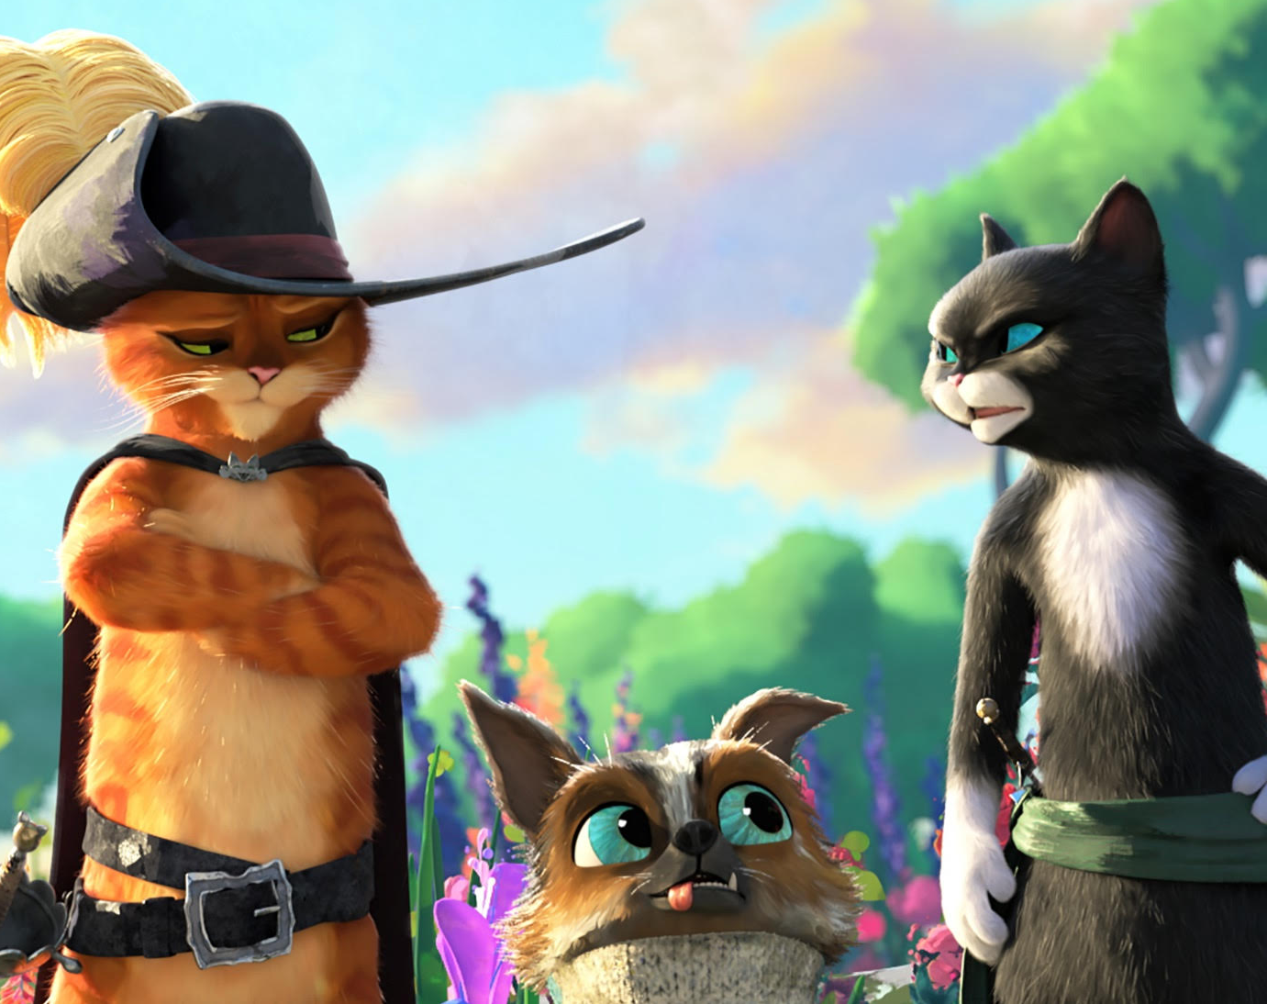
MEDIA SUMMARY
IN SUMMARY:
Promote the BBFC competition in Family films across Q4:
Family Major Release Film Packs – 14th October-31st December
30” Brand Ad (Film Packs in Lyle, Lyle Crocodile & Strange World) + 20” Bespoke Competition Ident (Closing Ident)
2,350,000 Admissions
£411,720 Ratecard
Digital Panels - 14th October-31st December
10” In Loop, Daytime Focus
3,200,000 Admissions (Budget on request)
Celebrate the partnership and showcase the winning design:
Puss In Boots: The Last Wish, Gold Spot – 3rd February-23rd March
30” Brand Ad + 30” Bespoke Competition Content (60”)
1,016,000 Admissions
£260,096 Ratecard
Please note: The length of the bespoke competition content is flexible and can be longer than stated above. Production costs associated with creation, DCP and distribution of assets to be factored in; The last campaign (Jurassic World) reached 976K people through BBFC and Universals social media channels, garnering over 1.4M impressions and 1,100 entries.

Slide 8
THANK YOU!
CONTACT YOU DCM REP FOR MORE INFO

