Slide 1
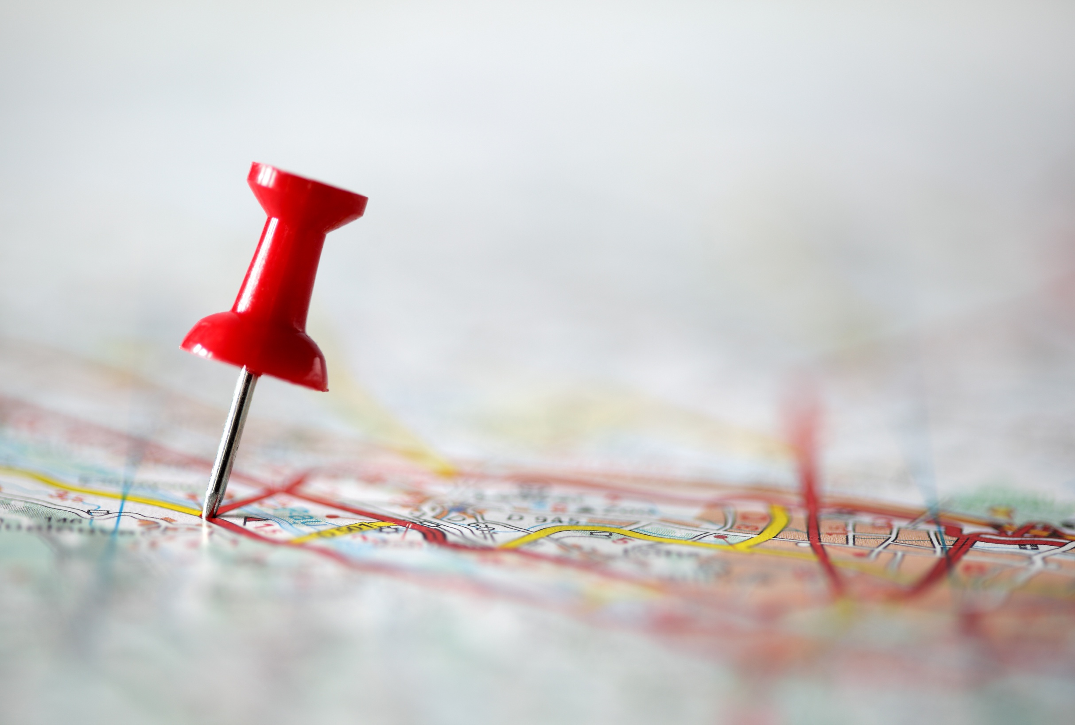
CINEMAPPER: PROXIMITY PLANNING
DCM’s proximity planning tool allows brand to geo-target and run smart, efficient cinema campaigns

Slide 2
Cinemapper can help your brand target more efficiently using cinema
Local targeting & End frame technology
DCM can map a client’s catchment area, branches, stores or local stockists…
To their nearest cinema sites based on distance in miles, drive time or walk time
Brands can also add a tailored 5” end frame to their main ad, delivering a national message with a local touch
Notes:
These 100 films account for 89% of UK admissions

Slide 3
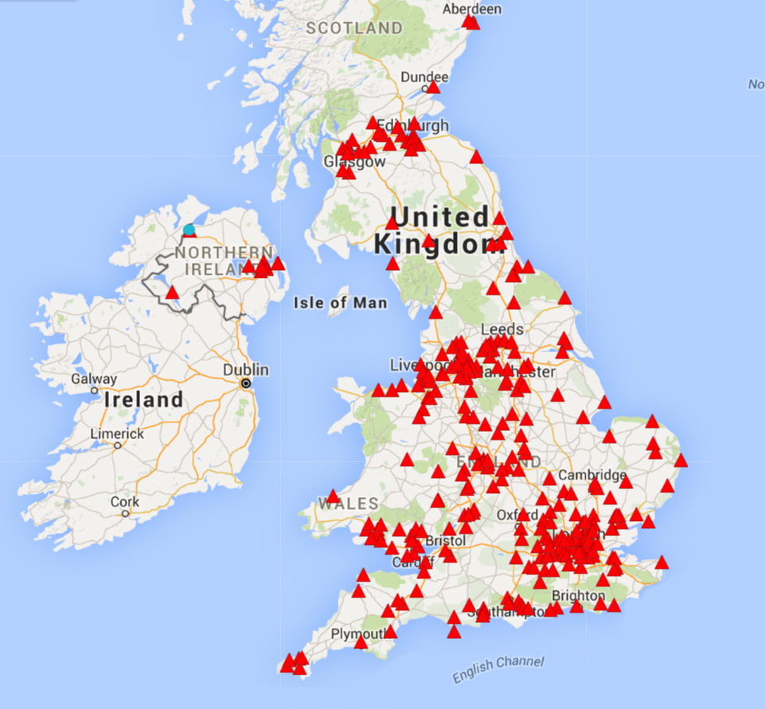
CINEMAPPER WILL ID MATCHES BETWEEEN A BRAND’S STORES/AOIS AND DCM CINEMAS
DCM can supply maps highlighting locations of matched DCM cinemas to demonstrate proximity to brand locations
Stores/Areas of Interest
DCM Cinemas

Slide 4

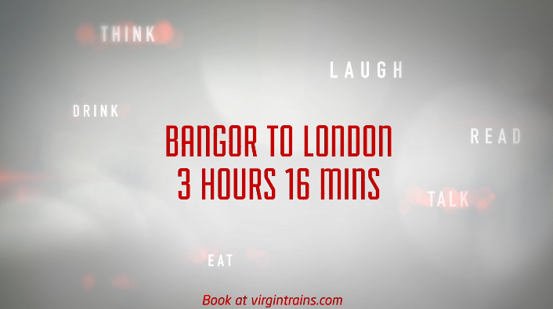
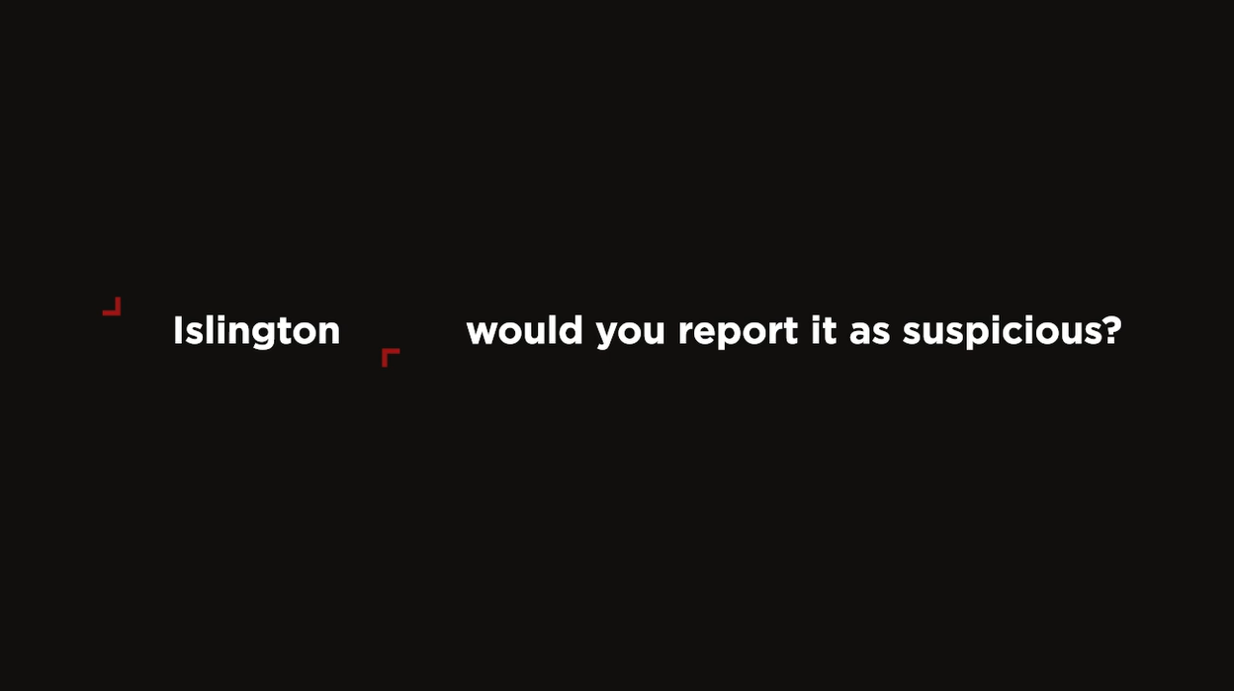

CREATIVE CAN BE TAILORED TO CAMPAIGN OBJECTIVES WITH BESPOKE END FRAMES
Ernest Jones
Virgin Trains
Highlighting nearest store to cinema to drive footfall
Promoting locally-relevant routes
Counter Terrorism Policing
Skoda
Targeting of key locations with tailored messaging
Showing nearest Skoda dealership

Slide 5

ERNEST JONES
DCM Awards Winner -
Best Use of Cinema (Small)
Celebrate Your Story
Sector | Target Audience | Package | Media Agency | Copy Length
Retail | ABC1 35-54 | ABC1 Ads AGP + House of Gucci | Bountiful Cow | 30” & 5”
Background
Ernest Jones wanted to tell a story that expressed its luxury credentials on a wider national level, driving mass reach but with a proximity focus to support the key outlets.
Ernest Jones chose cinema as they wanted to prioritise targeting in a premium environment that provides content that influences and creates emotional connections. The brand also saw the benefit of DCM’s Cinemapper planning tool that meant the campaign could target cinemas in proximity to its stores and inspire cinemagoers to visit their local Ernest Jones.
Plan
Nationally, the campaign ran in cinema sites that were within a 20-minute drive time of an Ernest Jones store. Ernest Jones handpicked House of Gucci as the perfect film fit for its campaign, aligning with the brand’s luxury credentials.
Given many cinemas are based in major shopping centres Ernest Jones wanted to make the most of sites where there was overlap and tailor a more targeted message. Where key Ernest Jones outlets and cinemas within shopping centres overlapped the brand ran its 30” copy (in a ABC1 Adult AGP and House of Gucci film pack) but added a bespoke 5” end frame that highlighted the store location of the nearby Ernest Jones to drive direct footfall.
Beyond cinema, the campaign also ran across TV, BVOD and YouTube & Print.
Results
Selecting cinema locations near Ernest Jones stores delivered an exceptional uplift in sales performance, demonstrating the power of cinema as both a brand-building and sales-driving platform:
Significant uplift in consideration
There was an increase of 39% of people who said they would consider shopping at Ernest Jones
Driving increase in sales:
The selected stores saw a 9% increase in attributed sales vs. 2019, outperforming other Ernest Jones’ outlets by 3%.
Source: Ernest Jones DCM Awards Entry

Slide 6

CINEMAPPER CASE STUDY: Mini
DCM Awards Winner -
Best Use of Targeting
‘Mini at the Movies’
Background
Mini is a well-known and much-loved brand, but the brand wanted to launch a campaign that was going to do more than reaffirm this love; it wanted to drive footfall into its specific local retail centres. It was a huge business interest to get car buyers behind the wheel of a Mini and to therefore drive leads so that retailers could follow up and encourage test drives.
Idea
Mini joined forces with its retailers to fund the first ever regionalised cinema campaign and get people across the UK to test drive its country model at their local dealership.
In collaboration Digital Cinema Media (DCM), Vizeum and Pearl & Dean created the first ever localised cinema campaign, spanning the breadth of the country.
Every single cinema screen location was mapped and matched them to its nearest Mini retail centre, using DCM’s Cinemapper tool.
Copy was delivered to every cinema with a bespoke end frame, directing cinemagoers to their nearest Mini retail centre, resulting in 147 pieces of copy generated onto 439 screens.
Cinemagoers up and down the country were treated to 30” edits of ‘A Passenger’s Guide to the New Mini Countryman’ followed by 3” localised end frames directing them to their nearest Mini dealership.
Results
Mini trumped its lead target, with the cinema campaign providing dealerships with 2,940 incremental and directly attributable test drives. Every single test driver walked away with a pair of cinema tickets, courtesy of their friendly local retailer, too!
Both Mini and DCM were delighted that they were able to set a new precedent in delivering a national campaign that could prompt a regional metric.
TO FILL OUT

Slide 7
CINEMAPPER CASE STUDY: rnli
DCM Awards Winner -
Best ‘Marketing for Good’
Respect The Water
Background
RNLI launched its behavioural change campaign in 2015, aiming to halve the number of people who lose their lives in the UK and Irish coasts by 2024. RNLI was particularly targeting young men, and wanted to use multiple touchpoints to effectively demonstrate the dangers that water can present
With this in mind, it aimed to give its young male audience timely and consistent prompts along their journey to the coast, hammering home its potential dangers.
Drawn to cinema’s engaging and immersive qualities, RNLI utilised DCM’s Cinemapper tool to pinpoint cinemas near rivers and seas. Activity was upweighted in these cinemas.
By upweighting in these coastal cinemas, RNLI was able to use a hard hitting AV creative alongside their outdoor campaign, prompting young men to think twice about irresponsible behaviour when temptation might be at its highest.
Results
The campaign, with cinema as an integral contributor, was hailed as a significant success, delivering an uplift in total campaign awareness of 36% and a 33% uplift in correct message takeout amongst 16-39 males.
81% of people who recognised two or more elements of the campaign said they understood the dangers were relevant to them.
RNLI recognised cinema’s ability to drive important messages home to engaged and attentive audiences. Cinemapper allowed RNLI to ensure that this message was being driven home in the right place, to the right people.
This relevancy meant RNLI saw great results and delivered a strong kick-start to a ten year campaign to change behaviours.
Campaign Details
Sector | Charity
Target Audience | 16-34 Males
Package | Male AGP with upweight in specific sites
Creative Agency | Leo Burnett
Media Agency | OMD UK
Duration | 3 months

Slide 8


CINEMAPPER CASE STUDY: Wagamama
‘Bowl To Soul’
Background
In a highly competitive casual dining market, wagamama recognised the need to stay fresh and relevant amongst its key 18-35 year old target audience.
‘Bowl To Soul’ was the centrepiece of wagamama’s biggest above the line advertising campaign to date, aiming to build brand loyalty amongst its target audience, giving them a strong reason to eat wagamama over competitors.
Cinema took on a leading role in the campaign - wagamama launched the ‘Bowl To Soul’ creative in DCM cinemas, ensuring its first AV advert was watched in the most engaging, immersive environment where the brand could captivate and entice the audience.
In an effort to drive footfall alongside brand impact, wagamama used DCM’s Cinemapper tool to locate cinemas in close proximity to its restaurants – allowing wagamama to buy selected sites that were within 10-15 minute drive of its restaurants to deliver close proximity and minimise wastage.
The ‘Bowl To Soul’ brand film ran in a total of 97 DCM cinemas across eight key cities identified by wagamama for this first campaign (inclusive of London). Across the summer the ad ran alongside screenings of blockbusters including Mamma Mia!: Here We Ago Again, Ant-Man & The Wasp and Mission Impossible - Fallout.
Results
Launching the ‘Bowl To Soul’ campaign in DCM cinemas has been a huge success of wagamama – helping the brand drive awareness and landing key brand perceptions of being a cool brand which makes people feel good.
Using cinema to target key restaurants allowed wagamama to test cinema’s effectiveness at driving sales and across an 11 week period UK like-for-like turnover increased by 12%.
DCM / wagamama / The7stars

Slide 9
CINEMAPPER: THE PROCESS
Planning a geo-targeted campaign is easy with Cinemapper – just supply us with a list of correct postcodes and the proximity you’d like us to plan against and we’ll do the rest. Let your DCM rep know if you’d like to factor in bespoke end frames to the costing too.
SUPPLY A LIST OF CORRECT POSTCODES FOR STORES
TELL US YOUR DESIRED PROXIMITY TO CINEMA
(MILES, DRIVE OR WALK TIME)
IN RETURN WE’LL SUPPLY MAPS, LIST OF MATCHING CINEMAS & TAILORED COSTING

