Slide 1
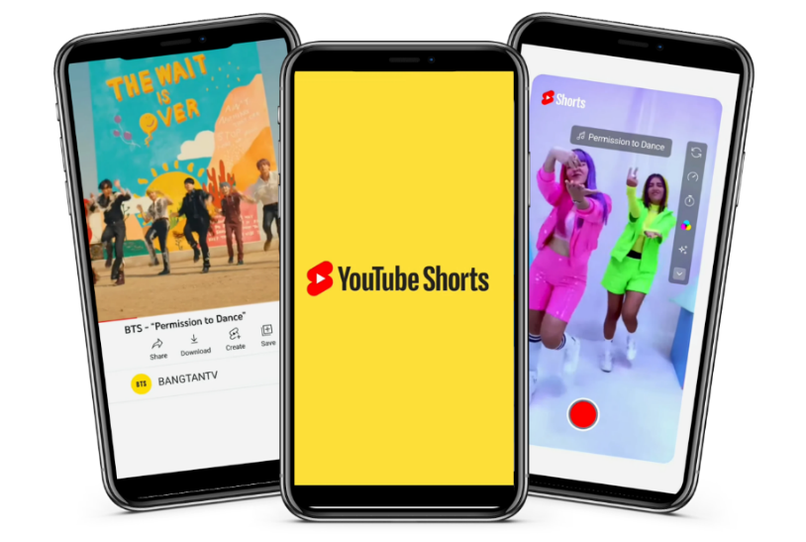
YouTube
YouTube Shorts Launch
Sector | Target Audiences | Package | Media Agency | Copy Length
Entertainment & Leisure | 16-34s | 16-34 AGP | OMD UK | 6” Blips + 20”
Background
Whilst YouTube remains an unparalleled force for long-form video, over recent years there has been a real shift in consumer behaviour towards shorter-form content and the likes of TikTok were surging in popularity.
YouTube launched its new snackable media platform - YouTube Shorts. The next generation of mobile-first creators would be able to create short, snappy and easily digestible content. YouTube then needed a big, bold launch campaign to break through the competition, drive attention and maximise awareness.
Plan
In partnership with DCM, YouTube was able to create a highly innovative Blipvert campaign that would disrupt the ad reel and generate intrigue around the launch of YouTube Shorts. Running as a sequence of 2 x 6” blips and a hero 20” AV creative, this format mimicked the 2 of 3 reel-like feel of the Shorts platform and helped YouTube dominate the cinema ad reel.
Buying a 16-34 AGP ensure the campaign ran within the most relevant film content for the target 16-34 demo, giving the brand access to some of the biggest films of the year: No Time to Die, Shang-Chi and the Legend of the Ten Rings, and Venom: Let There Be Carnage.
Alongside the on-screen activity, YouTube also bought into the foyer with cinema OOH panels reaching people in the foyers before the film. This not only allowed created multiple touchpoints across the cinema journey to drive frequency, but also extended reach to other cinemagoers who weren’t going to see one of the titles the campaign was running in.
Results
Cinema performed brilliantly with the campaign over-delivering by 200k admissions, and with a total of 600k cinemagoers seeing the OOH panels within the foyer.
Overall, it was a successful campaign and exposure to the cinema meant that YouTube were able to deliver on key brand metrics, including driving attention and maximising awareness to their target audience of young adults.
“We were very pleased to see the collaborative work with DCM to create unique blipvert formats to reflect our assets and overall new platform content. Overall, it was great launch of Shorts across cinema with stellar admissions and footfall over-delivery!”
Adam Burrows (Head of User & Subscriptions Marketing, UK at YouTube)
Source: Youtube DCM Awards Entry

