Slide 1
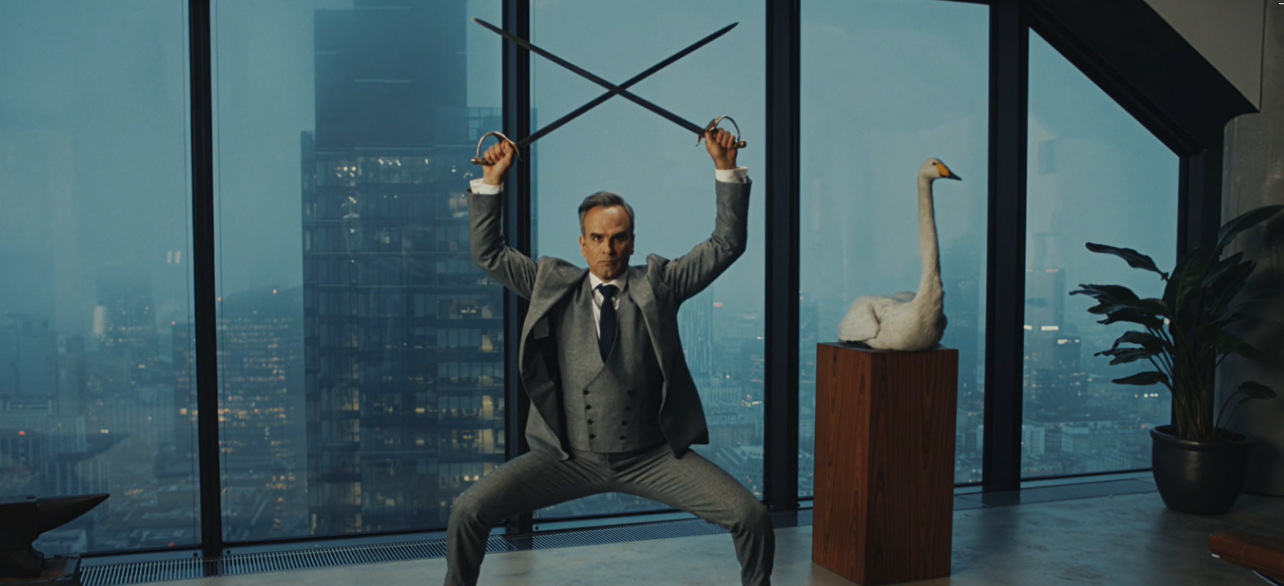
WILKINSON SWORD
‘Blade Masters’
SECTOR | TARGET AUDIENCE | PACKAGE | MEDIA AGENCY | COPY LENGTH
Personal Care | 18-34 Men | Film Pack | VCCP | 30”
BACKGROUND
Struggling to stand out against their competitors in the market, Wilkinson Sword knew they had to find a way to impactfully reach their target audience of 18-34 males. Looking to launch a new creative that would promote the quality of its products and good value credentials Wilkinson Sword ultimately wanted to re-assert the brand as high-quality and drive awareness & purchase consideration.
PLAN
Creatively, Wilkinson Sword wanted to comedically showcase the message of being ‘Blade Masters since 1772’, highlighting how its products are more reliable than others the market. Wanting to maximise reach in an attentive and engaging environment, Wilkinson Sword introduced cinema to the wider media plan for the first time, knowing it would also be an efficient way to reach a young men given the release of Deadpool & Wolverine.
The ‘Blade Masters’ 30” copy ran in-reel as part of a wider campaign that included BVOD, Social, YouTube & Outdoor.
RESULTS
Exposure to the Wilkinson Sword ad in the cinema significantly improved awareness and campaign recall, especially among existing razor users. Cinema also helped drive improved perceptions and consideration.
‘Wilkinson Sword is for people like me’
‘Wilkinson Sword is a brand I trust’
‘Intend to buy Wilkinson Sword
next time’
+8%
+12%
+35%
RECALL – Over half of cinemagoers recalled the ad, +34% uplift vs control
CONSIDERATION – Just under half of the exposed cinemagoers agreed they were very likely to consider Wilkinson Sword, +17% uplift from vs. those not exposed to the ad in cinema.
ACTION INTENT – 9 in 10 exposed cinemagoers intend to take some form of action, including over 2 in 5 intending to purchase the product.
Source: DCM / Wilkinson Sword. Conducted by; Differentology July 2024.
Uplifts are control (not exposed to ad in cinema) vs test (exposed to ad in cinema)

