Slide 1
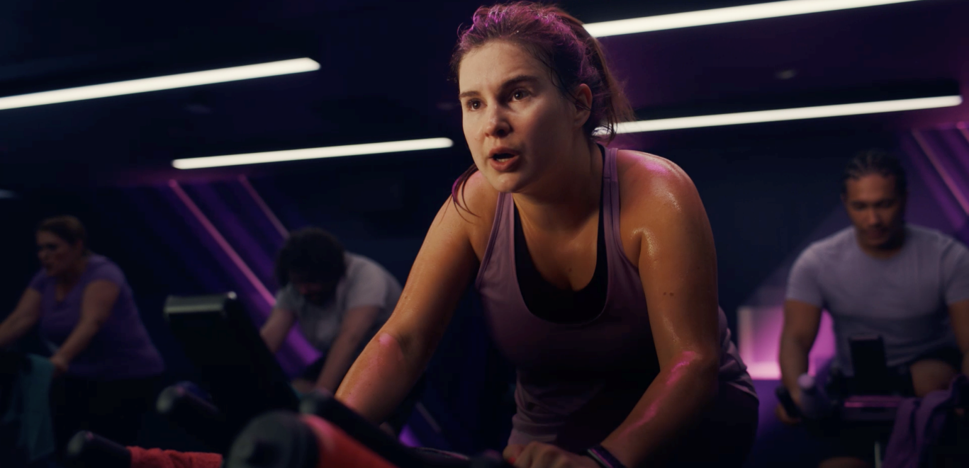
Virgin Active
Whatever gets you moving, it all counts
DCM Awards Nominee
Best Use of Cinema (Small)
Sector | Target Audience | Package | Media Agency | Copy Length
Health & Fitness | ABC1 Adults | ABC1 Adult AGP | Mindshare | 30”
Background
Virgin Active Clubs was facing an increase in competition from both high-end and low-end gyms and against a backdrop of the cost-of-living crisis decreasing disposable income for many, membership numbers had not yet returned to pre-pandemic levels.
To counteract this, Virgin Active wanted to promote an offer led campaign to build excitement around its gyms and stimulate growth in member sign-ups.
Plan
Virgin Active and Mindshare used DCM’s Cinemapper tool to plan efficiently, targeting cinema’s that were within a 30-minute drivetime radius of Virgin Active’s 34 clubs. This minimised wastage, ensuring they were targeting people most likely to join the gyms.
The campaign period, running from December to February was based on peaks in Virgin Active membership sign ups, where people were most likely to consider joining a gym.
Running in an ABC1 Adults AGP gave Virgin Active broad reach across demos appearing in reels ahead of titles including M3gan, Babylon, Triangle of Sadness, I Wanna Dance With Somebody and Empire of Light.
Cinema activity was part of a broader media mix that also included digital audio, out of home, press, broadcast VOD and connected TV.
Results
Starting with cinema as part of its plan proved successful for Virgin Active with the campaign driving a 14% lift in their sales vs. the budgeted sales target.
Cinema’s effectiveness, specifically the geo-target efficiencies allowed by planning through DCM’s Cinemapper, ensured the campaign was as effective as possible.
“Cinema activity was vital for Virgin Active to achieve impact and engagement with a captured audience. We focused on an audience buy that was layered with geotargeting cinema venues that had proximity to the clubs to drive efficiencies. Our overall cross media campaign drove a significant uplift in footfall to our clubs which we were delighted with.”
Caroline Macklin, Head of Brand, Virgin Active
Source: Virgin Active 2023 DCM Awards Entry

