Slide 1
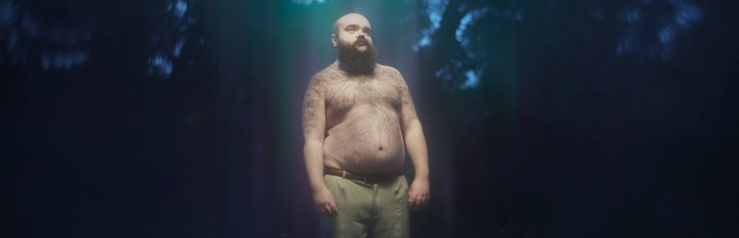
trainline
Great journeys start with Trainline
Sector | Target Audience | Package | Media Agency | Copy Length
Travel & Transport | 16-44 | Film Packs & 16-34 AGP | Wavemaker | 60”
Background
While most comms from train companies have typically focused on the joy of the journey or the destination, Trainline wanted to stand out by building an association with giving customers the best possible start they can have to their journey.
Launching the new brand platform - 'Great journeys start with Trainline’ – the brand also wanted to land key value messaging that customers can save 35% by booking tickets via Trainline
Plan
Wanting a highly attentive environment, Trainline knew that showcasing the 60” creative in cinemas would help drive cut through of the messaging and recall among its target audience. The campaign started with cinema as part of a wider multi-media campaign including BVOD, social, outdoor and digital audio .
Trainline secured the Gold Spot across key titles including Renfield and Evil Dead Rise and supplemented this with an in-reel 16-34 AGP to ensure the ad was delivered in highly efficient films for young adults.
Results
Starting with cinema helped deliver significant positive impact across key brand and campaign metrics for Trainline.
3 in 5 who saw the ad in cinema said that they were aware of the Trainline campaign, +7% from control who haven’t seen the ad on the big screen.
Seeing the ad in the cinema has helped the key value messaging cut through more with cinemagoers more likely to agree with the following statements:
Trainline offers the cheapest tickets - +25% uplift
Trainline offers the best value for money - +13% uplift
Trainline is more cost-effective than any other ticket booking app - +8% uplift
Almost 50% of cinemagoers associated the key ‘Save 35%’ message with Trainline and 74% associated the new ‘Great journeys start with..’ message with the brand too
Consideration of Trainline was higher for cinemagoers and 75% also report that they have a positive impression of the Trainline brand, +12% higher than control.
Over 8 in 10 cinemagoers said that they intended to take some form of action (e.g. visiting the app/website, booking a journey, mentioning it to family/friends) after seeing the ad, coming in significantly ahead of benchmarks.
Source: DCM / Trainline. Conducted by; Differentology, April 2023.
Results base: 16+. Uplifts are test (exposed to ad in cinema) vs control (not exposed to ad in cinema)

