Slide 1
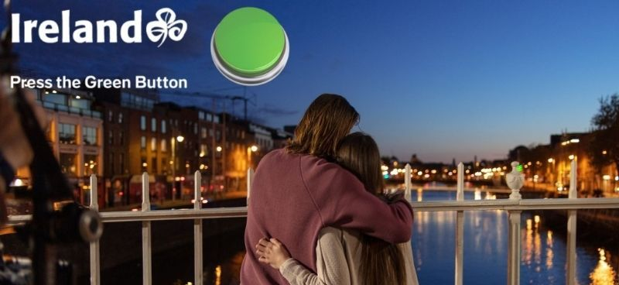
TOURISM IRELAND
Press the Green Button
Sector | Target Audiences | Package | Copy Length
Travel & Tourism | ABC1 Adults | ABC1 Adults AGP | 30”
Background
Tourism Ireland wanted to deliver its campaign at moments that aligned with passion points for its audience i.e., history, culture, art and travel. Knowing that cinema attracts a highly engaged, content-loving and culturally curious audience it was the perfect environment to showcase the ad, with the aim of boosting key metrics including consideration and planning a holiday to Northern Ireland.
Running in cinema only, Tourism Ireland launched the 30” creative across ABC1 Adult AGP, titles including Avatar: The Way of Water, Whitney Houston: I Wanna Dance With Somebody, M3gan, Babylon, The Fabelmans & Ant-Man And The Wasp: Quantumania
Results
Using cinema to reach the target ABC1 audience at time when they’re enjoying one of their cultural passions and in a high attention environment has delivered positive results across the key metrics for Tourism Ireland.
Ad Awareness - Over 1 in 5 Test cinemagoers were aware of recent advertising from Tourism Ireland promoting Northern Ireland as a holiday destination
Consideration – 69% of those exposed to the ad in cinema agreed they were likely to consider Northern Ireland as a holiday destination (+28% uplift vs Control)
Perceptions
- 86% agree that ‘Northern Ireland feels accessible to me’ (9% uplift from control)
- 76% agree that ‘Northern Ireland can fulfil my cultural curiosity’ (21% uplift from control)
- 77% agree that ‘Northern Ireland is somewhere I would like to visit’ (13% uplift from control)
Recommendation- 43% of test cinemagoers said they are likely to recommend Northern Ireland to family or friends as a holiday destination (+43% uplift vs Control)
Action Taken – 80% of test cinemagoers said that they have taken some form of action after watching the ad in the cinema e.g., mentioned to family or friends, searched for information online or visited the Northern Ireland website.
Source: DCM / Tourism Ireland. Conducted by; Differentology, February 2023.
Results base: 16+ ABC1 Adults. Uplifts are test (exposed to ad in cinema) vs control (not exposed to ad in cinema)

