Slide 1
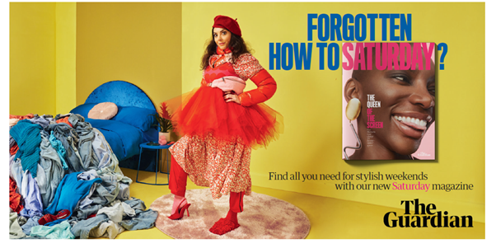
THE GUARDIAN
Saturday Magazine Relaunch ‘Forgotten how to Saturday?’
Sector | Target Audiences | Package | Media Agency | Copy Length
Entertainment & Leisure | ABC1 Adults | Film Pack, AGP | PHD Media | 30”
Background
The Guardian wanted to create an impact using cinema’s high-attention, premium environment to reach an ABC1 adult audience to relaunch its Saturday Magazine, as a super-sized 100+ page format which would sit inside the day’s paper.
The goal was to increase consideration to purchase or subscribe among key audiences. Specific targets included increasing newsstand market share and delivering 750 new subscriptions.
Plan
The Guardian specifically chose to run its 30” copy in showings of The French Dispatch – a movie which itself focused on the story of a fictional Kansas newspaper supplement produced in the late 60’s by American expatriates.
The 30” cinema spot became the hero piece of the relaunch, with its creative then being re-purposed in shorter formats in paid digital, social, and online video to increase awareness amongst both a current and prospective audience.
This was also planned alongside non-video formats including physically sampling copies of the magazine, using OOH and using the full suite of the Guardian's own channels such as press ads, social media, and a dedicated landing page on theguardian.com.
Results
Cinema activity over-delivered by 27%, driving impactful incremental reach and excitement around the launch of the Saturday Magazine.
In its launch week, the Saturday Guardian saw its highest market share for 19 months (since March 2020) at 18.2% and the weekends following launch continued to see an increase in year-on-year market share.
In total, the campaign drove 1,080 subscriptions, 52% higher than the previous period and 44% higher than the target of 750 new subscriptions that had been set for the campaign.
Source: The Guardian, DCM Awards Entry.

