Slide 1
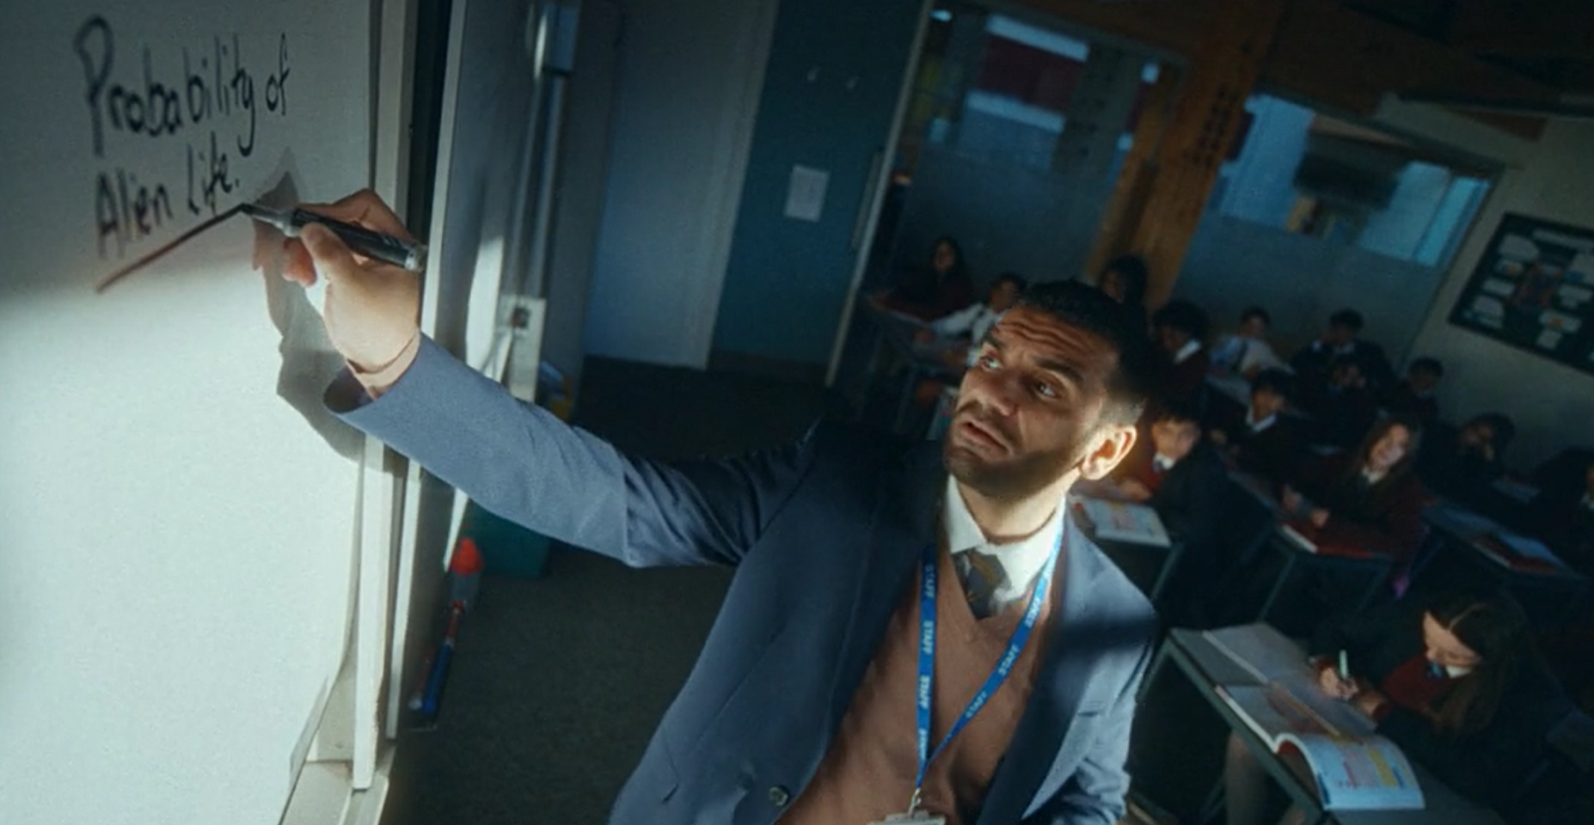
Teacher recruitment
Results
Consistent exposure to the ad in the cinema has helped improve DfE’s core KPIs, including boosting awareness and helping to drive conversion and consideration metrics, which ultimately led to online website traffic recruitment sign-ups.
Every Lesson Shapes a Life
Sector | Target Audience | Package | Media Agency | Copy Length
Government | 16-34 | AGP | MGOMD | 30”
58%
were able to recall having seen the ad previously, an 8% uplift from benchmarks
Background & Plan
In an effort to raise awareness among a new generation of potential teachers, the Department for Education (DfE) revamped their 'Every Lesson Shapes a Life’ creative, which showcases a real teacher who is positively impacting students' lives.
Wanting to inspire and attract new talent to the teaching profession by highlighting the numerous benefits, including lesser-known advantages such as diverse career paths and salary benefits, DfE ultimately aimed at increasing applications amongst a younger demographic.
Knowing how beneficial cinema has been in providing incremental reach to a younger skewing audience, in addition to an wider AV plan, DfE bought into an AGP across Jan – Mar 24 that would index strongly towards their target audience of 16-34s, giving them access to films such as Argylle, Migration, Madame Web & Bob Marley: One Love.
+17%
Exposure to the ad in cinema delivered significant uplift in ‘having a much better impression of teaching
35%
of respondents had said they were aware of the teaching ad when prompted, with directionally more test cinemagoers being aware than control
1 in 4
are intending to sign up to Get Into Teaching or start an application for teacher training after seeing the ad in the cinema, with 25% saying they are intending to visit the website
Source: DCM / Teacher Recruitment Conducted by; Differentology, Jan 2024.
Uplifts are control (unexposed to ad) vs test (exposed to ad)

