Slide 1
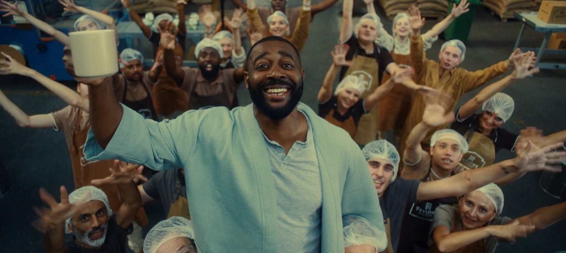
Taylors of Harrogate
Sector | Target Audience | Package | Media Agency | Copy Length
Household | ABC1 Adults | AGP + Film Packs | Goodstuff | 60”
‘It takes a big family to make a great coffee’
Background & Plan
Without a video asset for nearly a year, Taylors of Harrogate wanted to reintroduce the brand with a creative re-launch, focusing on the brand narrative rather than product specific advertising.
To stand out from competitors amongst their target audience of ABC1s and 35+ adults, Taylors of Harrogate knew that cinema would be an ideal channel to showcase the new master brand 60” creative in a premium visual environment to an engaged and attentive audience.
Taylors of Harrogate bought into an AGP in addition to several film packs running across the autumn including Napoleon, Killers Of The Flower Moon, The Hunger Games: Ballad of Songbirds and Snakes and The Marvels.
Cinema ran as part of a wider campaign alongside TV, BVOD, Social and Online where the brand showcased shorter length copy (30”, 20” & 10”).
Results
Exposure to the Taylors of Harrogate ad in cinema helped deliver on key campaign objectives of driving positive perceptions and consideration:
Awareness
Among those aware of the Taylors of Harrogate brand, cinema
delivered a 35% uplift in advertising awareness
Consideration
& Action
Consideration increased with a significant uplift of 17% for those who were exposed to the ad in cinema.
Almost a third of test respondents claimed to have bought Taylors of Harrogate coffee since seeing the ad.
Source: DCM / Taylor’s of Harrogate. Conducted by; Differentology, Oct 2023.
Results base: 16+. % agree (top 3 out of 10). Uplifts are test (exposed to ad) vs control (unexposed to ad)

