Slide 1
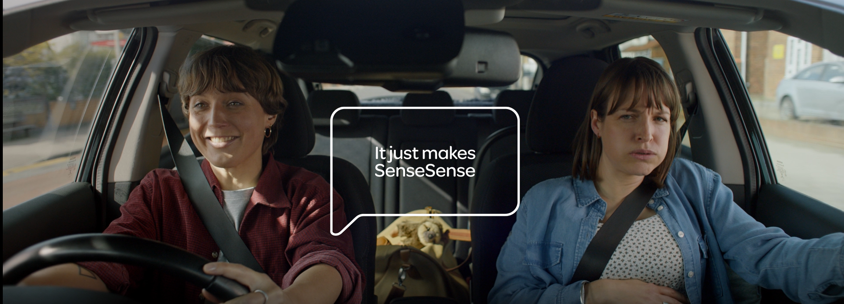
TALKTALK
It just makes ‘SenseSense’
Sector | Target Audiences | Package | Media Agency | Copy Length
Telecoms | Adults | AGP | m/Six | 30”
Background
In 2022, TalkTalk wanted to test to see whether including cinema in the AV mix would help drive brand salience, perceptions and ad recall.
With its core objective being to promote & drive consideration of the full fibre broadband product, TalkTalk included cinema knowing its strength as an environment for engaging a highly attentive audience with emotionally motivating benefits of its service.
Plan
Cinema was included on the AV plan alongside TV & BVOD with all channels running the same 30” creative to drive 1+ reach across all adults. Social, Online Video and Outdoor were also included in the mix too.
The ‘Pit Stop’ creative follows the story of a couple in a car, one of them pregnant, rushing to get to the hospital, when they realise, they are out of petrol. As luck would have it, a petrol station is nearby where the couple are greeted by a Formula 1-style pit crew, decked out in TalkTalk-branded overalls. The team quickly and efficiently fix their issue - emphasising that TalkTalk prioritises fast broadband speed for great value.
TalkTalk bought into an AGP to maximise all adult reach, which gave this campaign access to titles including The Batman & Fantastic Beasts: The Secrets of Dumbledore & Doctor Strange In The Multiverse of Madness.
Results
Exposure to the TalkTalk ad on the big screen drove significant uplifts across several important brand perceptions and key funnel metrics:
Almost half of cinemagoers recalled seeing the ad, 7% higher than Control
TalkTalk offers full fibre broadband at great value: +39% uplift
TalkTalk provides fast and reliable broadband: +29% uplift
Agree that the ad has left them a much better opinion of TalkTalk: +67% uplift
Consideration: +13% uplift overall; +27% uplift among those in market for broadband
These significant uplifts demonstrate how the engaging environment of cinema has helped deliver on key brand metrics that’s led to increased understanding of the TalkTalk proposition and had a positive impact on people’s impression of the brand.
Source: DCM / TalkTalk. Conducted by; Differentology, May 2022.
Results base: All adults 15+. Uplifts are test (exposed to ad in cinema) vs control (not exposed to ad in cinema)

