Slide 1
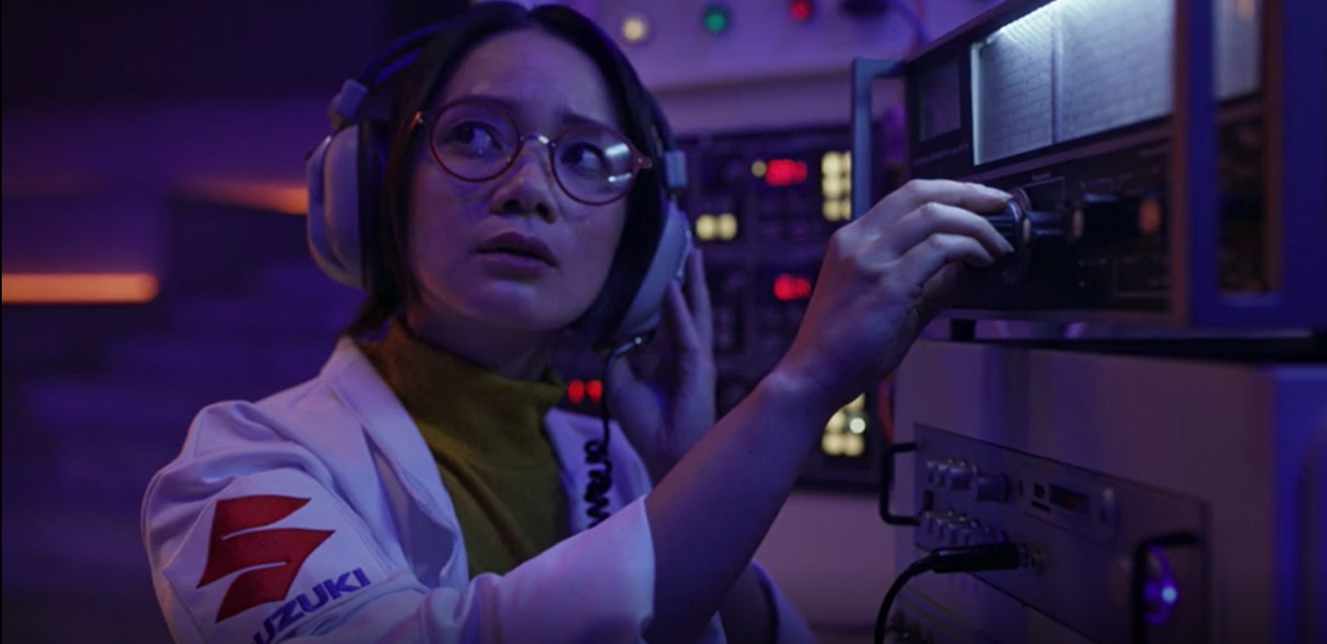
Suzuki
Good Different
Sector | Target Audiences | Package | Media Agency | Copy Length
Automotive | 25-54 ABC1 Adults | ABC1 & Family AGP | The7Stars | 60”
Background
With the launch of its new 'Good Different' brand campaign, Suzuki wanted to celebrate how its cars are different from everything else on the market, and importantly give customers everything they need – hybrid and new tech features - as standard.
Simplifying what is often over-complicated by other brands, Suzuki’s playful ad communicating this message was aiming to drive cut through and consideration with an ABC1 Adult audience.
Plan
Knowing that cinema can add valuable incremental reach in a highly attentive environment, Suzuki ran its campaign nationally on the big screen alongside a wider campaign including TV, BVOD, Social & Online.
Suzuki bought into a ABC1 and Family AGP to target an upmarket audience giving the campaign access to films including Elvis, The Black Phone, Thor: Love & Thunder, Minions: The Rise of Gru, Where The Crawdads Sing, Bullet Train and Nope.
Results
Results
The campaign was successful in driving significant uplifts across Suzuki’s brand metrics including awareness, key perceptions and consideration. This illustrates how the high-attention environment of cinema allows brands to engage an affluent target audience, land key messaging and have a positive impact across core KPIs.
Unprompted ad awareness: +69% uplift (vs 19% benchmark)
Much better opinion of Suzuki: +109% uplift (vs 40% benchmark)
Likely to consider Suzuki: +88% uplift (vs 16% benchmark)
Source: DCM / Suzuki. Conducted by; Differentology, August 2022.
Results base: ABC1s. Uplifts are test (exposed to ad in cinema) vs control (not exposed to ad in cinema)

