Slide 1
SAINSBURY’s
A Christmas To Savour
Campaign Details
Sector | Target Audience | Package | Media Agency | Copy Length
Retail | Main Shoppers | HFSS AGP | PHD | 60”
Background
After many missed out on a full Christmas experience in 2020, Sainsbury’s wanted to embrace how people were looking forward to Christmas so much and wanting to savour every precious, delicious, magical bit of it.
The aim of its “A Christmas To Savour’ campaign was to show people how they can enjoy the Christmas moments we’d all been waiting so long for and centre the campaign on food, placing new products at the heart of the festive campaign and highlighting Sainsbury’s as the supermarket destination with a delicious Christmas offering.
Plan
Sainsbury’s wanted to dial up “togetherness” and indulgence” through its media selection across the festive period. Cinema fit this brief perfectly as it’s a shared, co-viewing environment and dials up multiple senses through being the most premium AV experience available.
Alongside TV, BVOD/Online video, Social, Outdoor, Press, Radio and an Acast partnership cinema was added to the mix to help drive reach, impact, memorability and showcase the 60” ad in its fullest glory.
Running from mid-November to Christmas Eve in cinemas, Sainsbury’s bought a HFSS AGP running in reel across a range of films including Ghostbusters: Afterlife, King Richard, House of Gucci and West Side Story
Source: DCM / Sainsbury’s
Conducted by: Differentology, Dec 2021
Base: 18+ adults

Slide 2
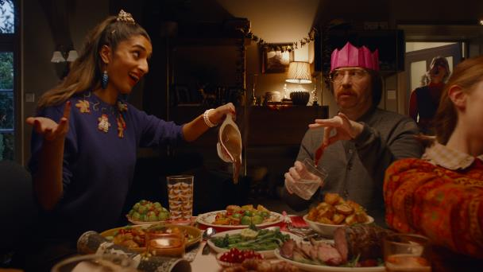
Sainsbury's
A Christmas To Savour
+23% Uplift
+28% Uplift
+25% Uplift
69%
of cinemagoers
recalled seeing the Sainsbury’s ad
(vs. 44% benchmark)
Summary
Increase advertising awareness and consideration:
Cinemagoers exposed to the ad on the big screen during the campaign were 23% more aware of recent advertising by the brand and 25% more likely to say they would consider shopping at Sainsbury’s compared to control.
Cinema successfully allowed Sainsbury’s to showcase its full 60” TVC in a shared environment where it could cut through, drive perceptions of premium quality and ultimately drive consideration of Sainsbury’s Christmas product range including specific hero products (e.g. gammon, chicken waffles and chocolate caramel star) featured in the ad.
Driving key brand perceptions further:
Cinema exposed respondents were 36% more likely to agree ‘Sainsbuy’s have everything you need for Christmas’ and 58% more likely to agree ‘Sainsbury’s makes me look forward to Christmas’ vs. control.
Cinema exposed = 53%, Control = 39%; Cinema exposed = 49%, Control = 31%
Positive brand impression
65% of cinema exposed respondents agree the campaign has a positive impact on their opinion of Sainsbury's after seeing the ad on the big screen, compared to 29% of the no-cinema exposure control respondents.
Source: DCM / Sainsbury’s
Conducted by: Differentology, Dec 2021
Base: 18+ adults

