Slide 1
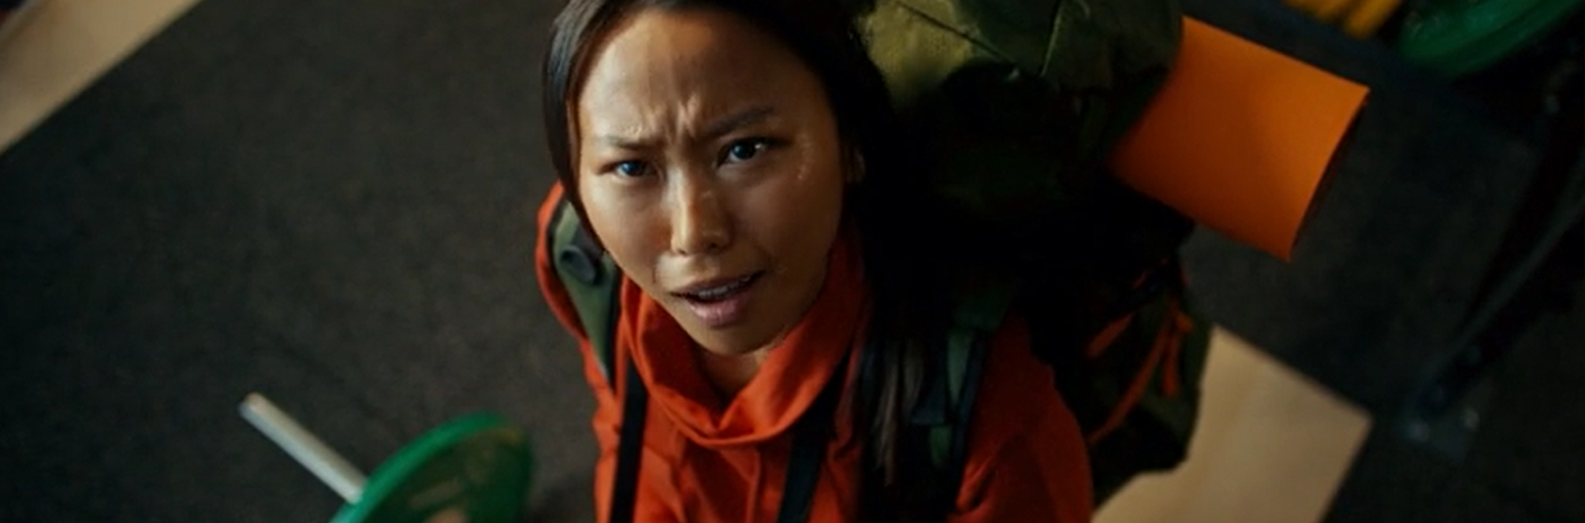
Puregym
‘Way More Than You Pay For’
Results
Exposure to the ad in the cinema was found to significantly increase PureGym’s target audiences core brand metrics and despite PureGym already being quite a well-established brand, this cinema campaign was successful in helping to significantly boost lower funnel metrics including overall conversion & consideration to join a PureGym.
Sector | Health & Wellbeing
Target Audience | 18-34
Package | Film Packs
Media Agency | Carat Leeds
Copy Length | 30”
Brand Awareness
Consideration & Action
9 in 10 respondents had heard of PureGym when prompted, with directionally more test cinemagoers being aware than control
Exposure to the ad in cinema delivered a 19% uplift in ‘very likely’ to consider joining a Puregym & 29% uplift in intending to visit a branch
Background
As an already established brand, PureGym wanted to cement their reputation as a low-cost, high quality and flexible gym and solidify its position as the top choice for budget-conscious fitness enthusiasts. The launch of their new creative, ‘Way More Than You Pay For’ focused on the value and benefits each member gets, particularly during times of increased living costs.
PureGym aimed at expanding reach to potential customers, driving awareness, consideration to sign up and strengthen perceptions surrounding value for money and overall quality.
Plan
Knowing how cinema is beneficial in providing incremental reach to a more engaged audience, on top of an existing AV plan PureGym bought into film packs across Dec 23 – Feb 24 that would index strongly towards their target audience of 18-34s, giving them access to Wonka, Aquaman & The Lost Kingdom, Next Goal Wins and Night Swim.
PureGym ran cinema nationally as part of a wider campaign using the same 30” copy & a 10” version across TV, BVOD, Radio & Digital Audio.
Associations
Perceptions
Exposure to the ad in the cinema drove a +10% uplift in association with being ‘good value for money’
Perceptions significantly improved, with the highest uplifts seen for ‘PureGym is for people like me’ (+46% uplift) and ‘is a brand I trust’ (+28% uplift)
Source: DCM / PureGym Conducted by; Differentology, Dec 2023.
Uplifts are control (unexposed to ad) vs test (exposed to ad)

