Slide 1

PREMIER INN
‘A Great Place To Start’ - 2016
Background
Premier Inn advertising had traditionally become associated with the presence of Lenny Henry. However in 2016 the brand wanted to evolve what its positioning and launched its new ‘A Great Place To Start’ proposition.
The aim of the new campaign was to avoid cheesiness and help position the Premier inn brand as standing for “more than just a bed” which would help deliver an increase in brand preference and consideration.
Idea
AV channels remained at the heart of Premier Inn’s media mix and so a series of ads were created, directed by British filmmaker Ben Wheatley, telling the light-hearted stories of various customer archetypes including a young mum, a group of scaffolders and Great Aunt Mabel.
Plan
Cinema was a natural fit for the campaign given the creative pedigree behind the new ads and Premier Inn wanted to extend their usual AV strategy (using TV and VOD) to tell a richer story across screens of all sizes and boost recall of the campaign.
Premier Inn decided to showcase its ‘Great Aunt Mabel’ creative in cinemas – an execution designed to target an ABC1 family audience. With this mind, Premier Inn bought a film pack in the highly anticipated Fantastic Beasts And Where To Find Them.
Campaign Details
Sector | Travel
Target Audience | ABC1 Families
Package | Film Pack
Media Agency | MGOMD
Creative Agency | Lucky Generals
Duration | 60”

Slide 2
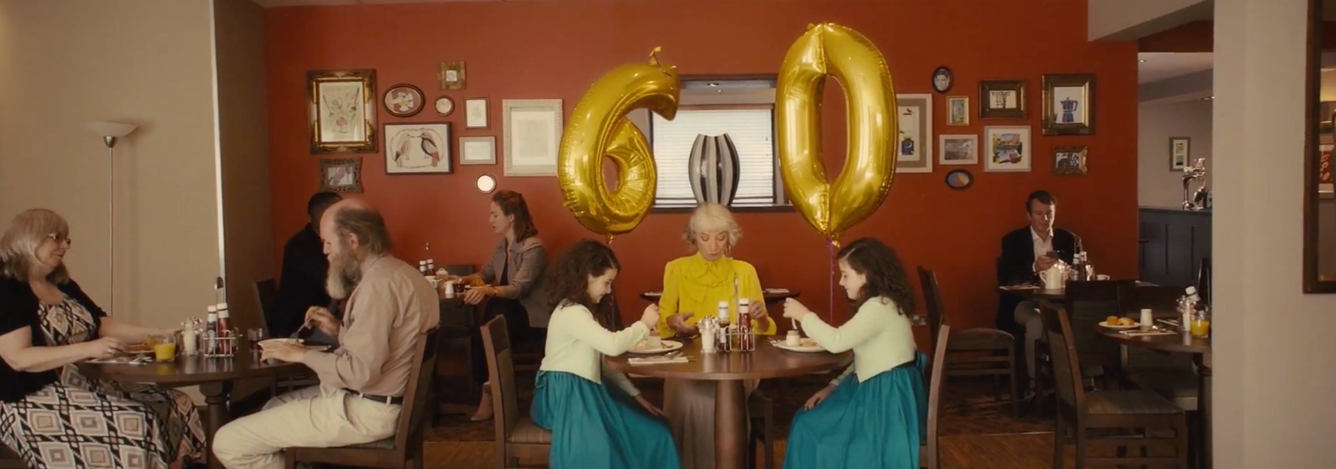
PREMIER INN
‘A Great Place To Start’ - 2016
Results
Uplift in spontaneous brand awareness:
Cinema exposed 30% more likely to be aware of Premier Inn vs. control (no exposure in cinema)
Cinema exposed = 54%, Control = 33%
Summary
Adding to cinema to its AV mix has helped Premier Inn drive brand awareness, campaign cut through and consideration of its service among its core target audience of upmarket families.
Increase in consideration:
Those exposed to the cinema activity are 5% more likely to consider Premier Inn vs. control
Cinema exposed = 78%, Control = 74%
Uplift in comms awareness:
Cinema exposed 27% more likely to be aware of the Premier Inn advertising vs. control
Cinema exposed = 57%, Control = 45%
Source: DCM / Premier Inn
Conducted by; Differentology, November 2016

