Slide 1
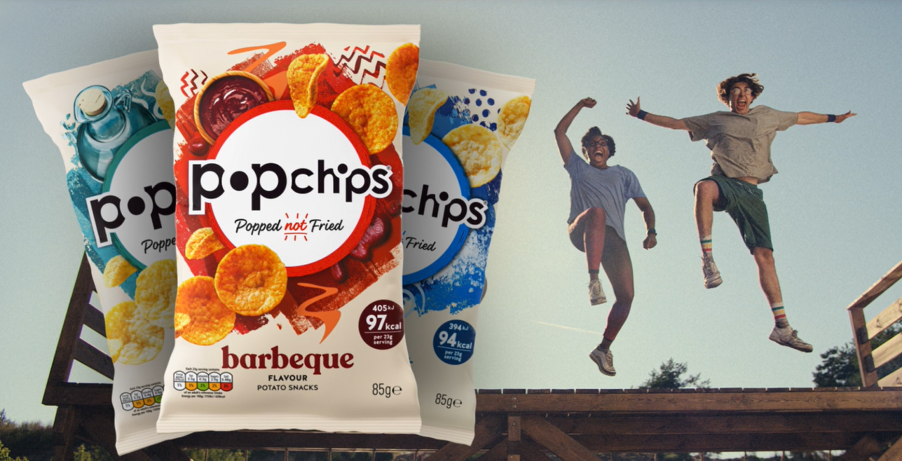
popchips
Sector | Target Audience | Package | Media Agency | Copy Length
FMCG | Adults | Film Packs | Starcom | 20”
‘Start Something Good’
Background & Plan
Being new to cinema, Popchips wanted to launch their brand and message across an attentive space to showcase their existing 20” TVC across a wide range of films in Q4 of 2023.
Popchips saw cinema as the perfect medium for boosting salience in a shared environment, to drive impact and recommendation vs their already established competitors.
Their key objective for this campaign involved driving purchase intent across their target audience of adults who buy crisps, testing cinema's ability in driving conversion metrics.
Using their ‘Start Something New’ copy, Popchips started with cinema, accessing several popular films running across the end of the year, including The Hunger Games: Ballad of Songbirds and Snakes, Killers of the Flower Moon, The Marvels and Aquaman and the Lost Kingdom.
Results
Cinema exposure significantly improved upper- and middle-funnel metrics including awareness, key perceptions, consideration and intention to purchase:
+52% uplift
+46% uplift
+52% uplift
+63% uplift
Impressions
Cinema delivered a +32% uplift in positive impressions of the Popchips brand
Brand Awareness
61% of those exposed to the ad in the cinema were aware of Popchips, a 9% directional uplift from the control group
Consideration
Consideration of Popchips significantly increased by
+27% when exposed to the ad in cinema
Action
c.60% of Test cinemagoers intend to buy Popchips
as result of this campaign
Source: DCM / Popchips. Conducted by; Differentology, Oct - Nov 2023.
Results base: 18+ Uplifts are test (exposed to ad) vs control (unexposed to ad)

