Slide 1
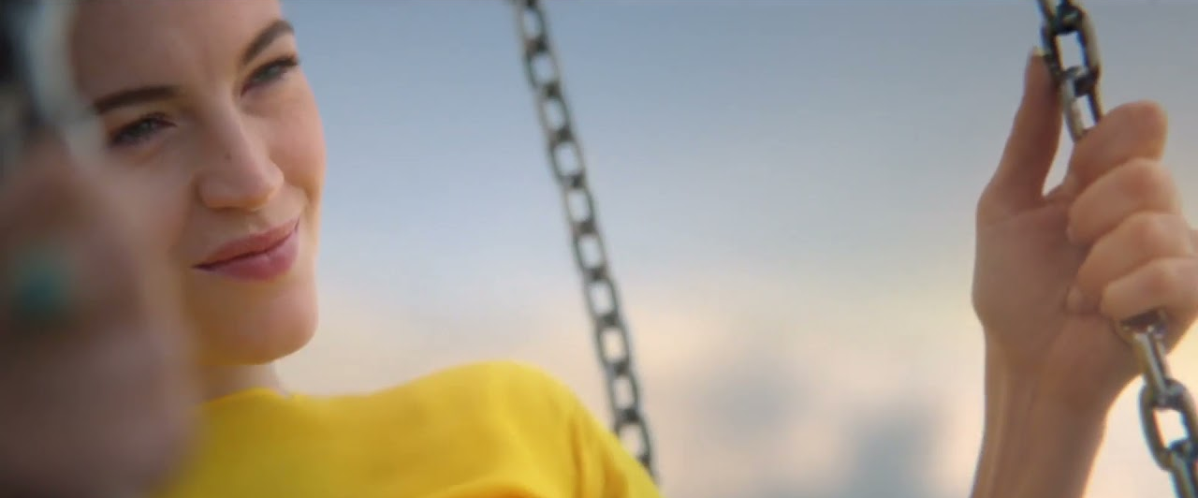
Peugeot
Peugeot 308
Sector | Target Audiences | Package | Media Agency | Copy Length
Automotive | ABC1 Adults | Film Pack + Exhibitor Spot | Starcom | 30”
Background
Peugeot wanted to dispel perceptions that the brand was outdated, after customer insights revealed that ‘French’ and ‘cheap’ were the terms most used to describe Peugeot. With the launch of the new Peugeot 308 Hybrid, they wanted to convey the allure of the model in an impactful and creative way through bespoke content.
Peugeot’s media objectives were to land the new 308 model as upmarket and the embodiment of the new brand vision, and ultimately driving consideration and leads.
Plan
The broad appeal of Top Gun: Maverick was the ideal film for Peugeot to have the opportunity to appeal to both a new generation of buyers and an older audience who may be current or previous Peugeot buyers. So ideal that cinema launched a week earlier than the rest of the campaign to make sure Peugeot didn’t miss out on any of the Top Gun: Maverick magic.
To drive further cut through and resonance as part of the ad reel in Odeon cinemas, Peugeot also ‘took over’ one of the core exhibitor spots - taking it’s escapist AV copy and weaving this in with the cinema’s ‘Turn Your Phone Off’ messaging.
Results
Peugeot saw a 17% uplift in leads from May to June and 308 leads specifically increased by 45% - as Cinema was the only media live in May these results can be directly attributed to the impact of the big screen.
Peugeot also saw a significant uplift in consideration, with search results also 10x higher during the period cinema activity was live compared to levels prior to the campaign.
Source: DCM / Peugeot

