Slide 1
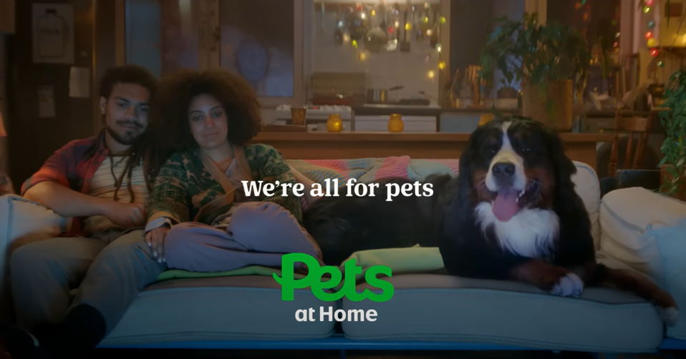
PETS AT HOME
We’re All For Pets
DCM Awards Nominee
Best Use of Cinema (Large)
Sector | Target Audience | Package | Media Agency | Copy Length
Retail | Families | AGP | Carat UK | 60”
Background
Pets at Home is known as the nation’s largest pet retailer, operating various consumer-facing propositions including retail, veterinary and grooming services. However, it felt faced with the challenge of being perceived as a disconnected collection of brands rather than a unified and expert pet care company. With increased competition in the pet care industry due to the pandemic-driven surge of pet buying, the company wanted to enhance its position and drive consideration.
To achieve this, Pets at Home underwent a brand refresh, adopting a cohesive and softer brand identity under the positioning "We’re All for Pets”. The goal was to become the top choice for pet care, emphasising their industry-leading expertise and authority, and the positive impact they have on pets’ lives.
Plan
To launch its new brand positioning, Pets at Home utilised cinema advertising as a high-attention, high-recall platform, in addition to its cost efficiency in being able to deliver incremental TVRs to the wider AV plan.
Recognising the potential of high attentive reach, it was clear that an engaging creative would showcase the many reasons to believe in Pets at Home. Creating a 60” creative to connect with pet owners emotionally, they used the iconic Meat Loaf song “I’d Do Anything For Love” as a nod to the bond between pets and their owners.
Running for 6 weeks across the spring, Pets at Home accessed a number of highly efficient titles for its target audience of families including Spiderman: Across The Spider-Verse and The Little Mermaid to ensure maximum visibility and reach.
Results
Overall, the results were impressive and demonstrated the effectiveness of starting with cinema, with uplifts in Pets at Home’s key brand metrics including:
- 70% increased recall of Pets at Home
- 74% recognised the brands as part of one united group.
- The perception of the company as an authoritative and industry-leading pet care brand grew significantly.
- 89% felt Pets at Home provided quality products and services, with 85% adding they felt Pets understood them and their pet’s needs (+9% uplift)
- 80% of surveyed individuals also claimed to have taken tangible actions since the campaign including shopping or utilising Pets at Home services.
This success validates the effectiveness in cinema at the launch of a campaign, helping to create strong emotional connections with customers, and driving substantial business growth.
Source: Pets at Home DCM Awards Entry 2023

