Slide 1
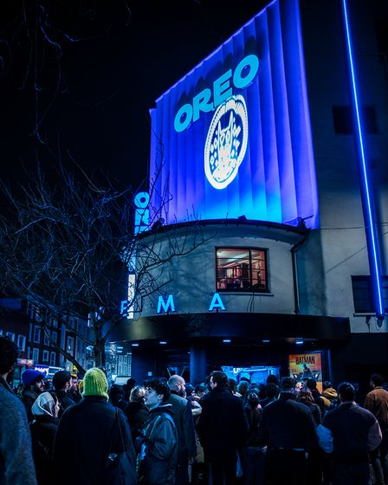
OREO
OREO x The Batman
Sector | Target Audience | Package | Media Agency | Copy Length
FMCG | 18-34s | DCM Studios x HFSS AGP | Carat | 30”
Background & Plan
Oreo wanted to reach a young audience and elevate its campaign with an immersive experience that would delight the audience while also driving fame & talkability.
Collaborating with DCM Studios & ElevenFiftyFive, Oreo wanted to captivate cinemagoers with a Gotham-City inspired Oreo experience to coincide with the release of The Batman over its opening weekend. The three-day experience hosted by East London’s Rio Cinema formed part of a broader partnership that included a 30” ident running in HFSS AGP titles.
At the Rio Cinema the opening weekend takeover saw the venue taped off as a crime scene in which everyone in the audience was a suspect. Only by teaming up with other guests, Oreo delegates and the Gotham City Police Force could the trail of cookie crumbs be followed to unmask our OREO thief.
To complete the picture all signage was given an Oreo-themed makeover including the ticket kiosk, branded vinyl wall coverings and as many ‘Oreo x The Batman’ embossed cookies as you could eat.
Results
Cinema delivered on Oreo’s key objectives of connecting meaningfully with its target audience while also driving fame and talkability. The opening weekend takeover drove over 1,300 attendees to the RIO cinema with the average number of people per showing double that of the rest of DCM’s estate for the opening weekend.
Increase awareness & fame
Top-of-mind brand awareness increased by 16% for Oreo
Recall of the Oreo x Batman partnership was 166% higher for cinemagoers vs. control group
Significant uplift in brand perceptions & consideration:
Increases in key perceptions including ‘tastes great’ (+5%), ‘is a brand for me’ (+6%), ‘is high quality’ (+9%)
6 in 10 agreed it made them more likely to consider buying Oreo
Source: Oreo DCM Awards Entry

