Slide 1
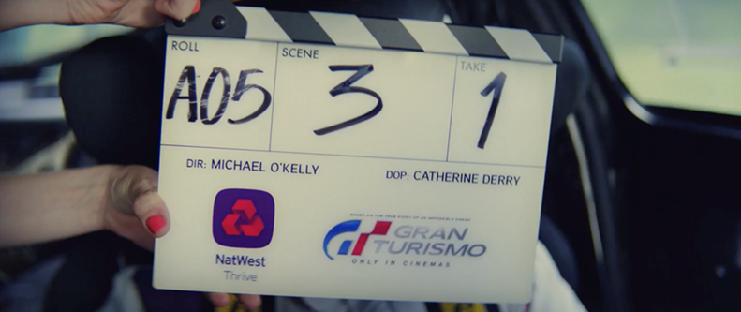
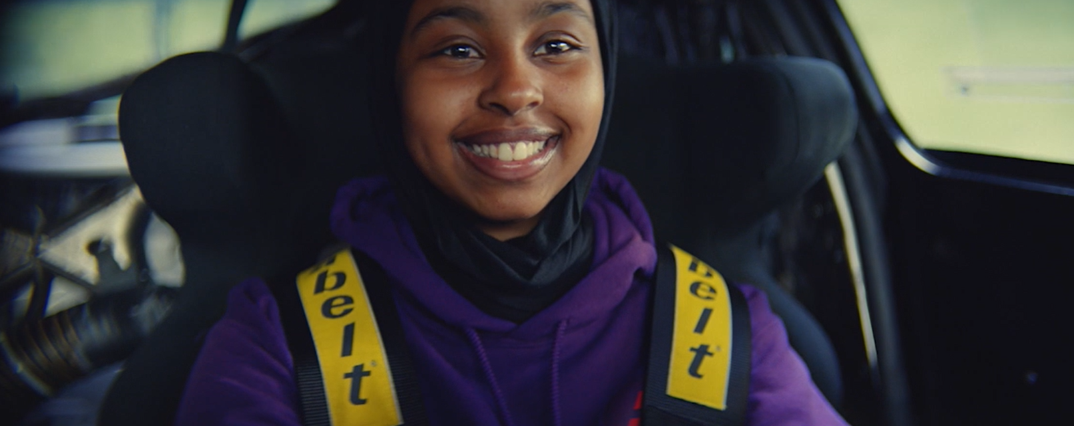
NATWEST
Sector | Target Audience | Package | Media Agency | Copy Length
Finance | 16-24s | Film Partnership | Initiative | 60”
Thrive & Gran Turismo Partnership
Background
NatWest wanted to raise awareness of NatWest Thrive, a money-confidence program designed to help young people develop the self-belief, confidence and money skills to achieve their aspirations.
Knowing that contextualisation of the ads will help boost engagement and cut-through, the bank collaborated with DCM Studios and Sony Pictures to create a film partnership with Gran Turismo.
The film was based on a true story of a computer game player whose dreams of racing professionally come true after being scouted by Nissan. The film’s themes of dedication and commitment leading to a dream becoming reality, made it (and cinema) the perfect for NatWest to showcase the Thrive program to a teenage/young adult audience.
Plan
The DCM Studios produced 60” copy showcases 9 aspiring film makers on site recreating a shot from the film, with Sony providing the car that was used in the filming of Gran Turismo.​
The teenagers got hands-on experience working with a professional team including a lighting technician, camera operator, boom operator in a once in a lifetime experience to help their dreams of becoming film makers reality. ​
Before running in a Silver Spot in Gran Turismo, NatWest also ran the ad across 16-34 Adults AGP titles across July – August to build up awareness of the campaign.
Click here to watch the ad
Source: DCM / Natwest Conducted by; Differentology, September 2023.
Results base: 16+. Uplifts are test (exposed to ad) vs control (unexposed to ad)

Slide 2
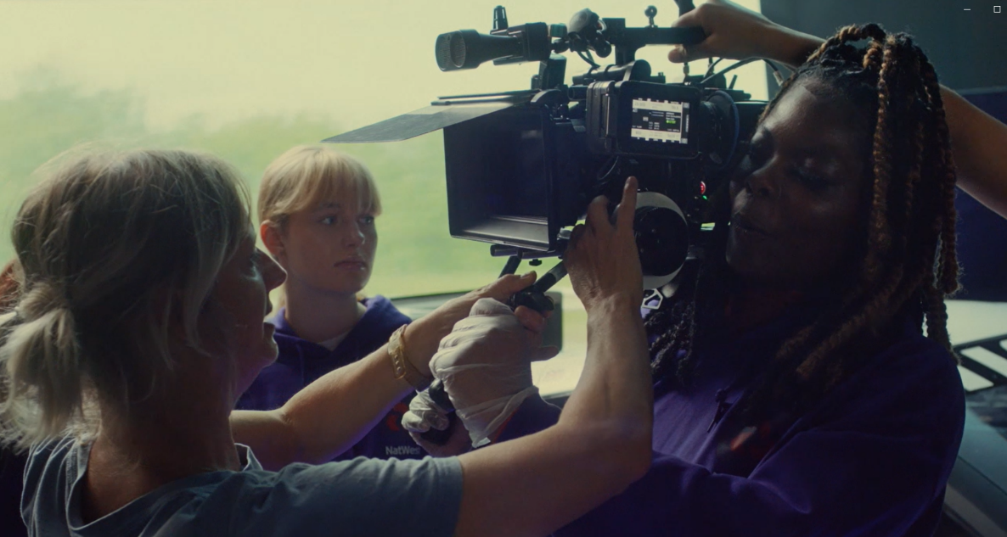
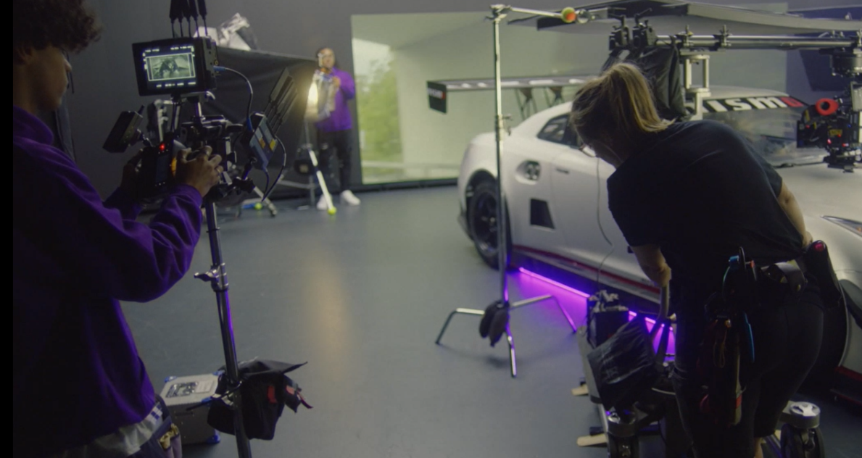
NATWEST
Thrive & Gran Turismo Partnership
Results
Exposure to the contextual Natwest Thrive ad in cinema helped improved NatWest’s key campaign objectives of driving awareness and consideration of the Thrive program:
+80% uplift
+80% uplift
+52% uplift
Awareness and Associations Improved
Prompted awareness of NatWest Thrive has increased by +233%
+29% uplift for key ‘NatWest gives people the confidence to kickstart their future’ statement
Improved Consideration & Recommendation of Thrive
Two thirds of those exposed to the cinema ad are likely to consider NatWest, +46% uplift vs. control.
Likelihood of recommending the NatWest Thrive program to family or friends increased by +89%
As well as contributing to awareness and engagement for NatWest's Thrive program, the campaign had a real-life impact on the aspiring film makers and has led to paid work on other projects since.
Source: DCM / Natwest Conducted by; Differentology, September 2023.
Results base: 16+. Uplifts are test (exposed to ad) vs control (unexposed to ad)

