Slide 1
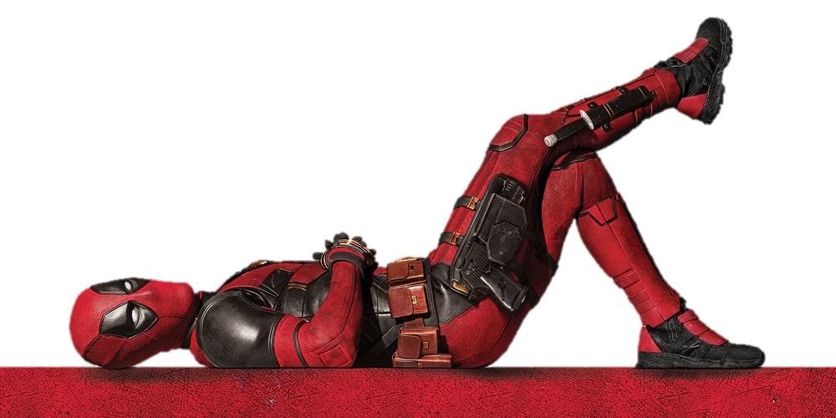
NHSBT X DEADPOOL & WOLVERINE
FILM PARTNERSHIP

Slide 2
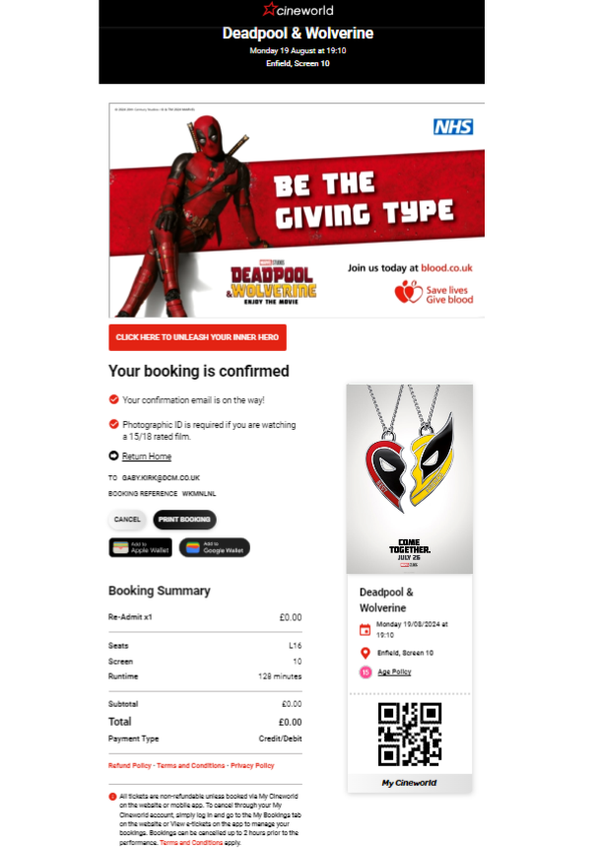
NHSBT X DEADPOOL
Film Partnership
Background
NHS Blood and Transplant have teamed up with two of Marvel’s most-loved superheroes in the new Deadpool & Wolverine blockbuster hit, to encourage and inspire potential blood donors to sign up to give blood and save lives.
Idea
At the centre of this partnership is a 30” cobranded advert, in which Deadpool & Wolverine stars Ryan Reynolds and Hugh Jackman encourage potential donors to sign up to donate blood, in their own cheeky and charming manner.
This 30” cobranded advert ran ahead of all 12A+ titles at Cineworld and Vue cinemas located within a 25-minute drive from a blood donor centre. DCM’s proximity planning Cinemapper tool was used to identify these locations, in order for NHS Blood and Transplant’s campaign to target ideal customers and maximise impact.
In addition to the 30” cobranded advert, the cinema partnership included in-foyer digital 6-sheets across targeted cinemas. Online elements also played a key part in this partnership, with a media-first booking confirmation page takeover, and organic and paid activity across social media.
The booking confirmation page was a highly valuable touchpoint, capturing cinemagoers' attention at a moment when they’re already emotionally invested in their upcoming cinema trip.
Campaign Details
Sector | Public Sector | Media Agency | MGOMD/Omnicom
Target Audience | 17-24 | Creative Agency | DCM Studios
Package | Digi Screens | Duration | 8 weeks

