Slide 1
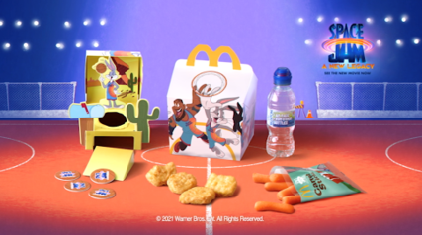
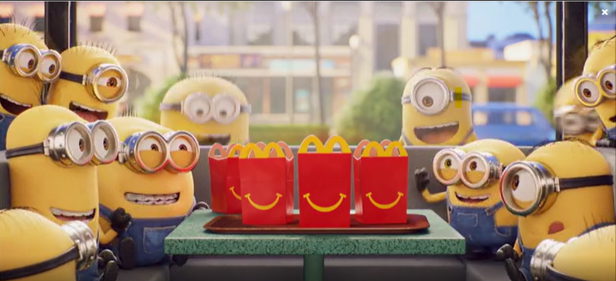
MCDONALD’S
Happy Meal
Sector | Target Audience | Package | Media Agency | Copy Length
Entertainment & Leisure | Families | Family AGP Bronze Spot | OMD UK | 30”
Background & Plan
Due to the changing media landscape with declining children’s TV consumption and increased restrictions around HFSS advertising, it was becoming more difficult to talk to Parents and Kids aged 4-7 about Happy Meal.
McDonald’s needed to find a solution that provided them with an environment they could reach dual viewing more effectively, reconnecting with families to drive nostalgia and remind them all the reasons why they love Happy Meal – and ultimately improve ROI.
DCM and OMD collaborated to create a long-term Bronze spot partnership that gave McDonald’s access to every family film – this would help establish a long-term association in cinema’s premium environment as well as also driving cut through within the ad reel.
McDonald’s ran various 30” creatives across the year to reflect the current in-store Happy Meal promotions and was featured in the reel ahead of titles including Space Jam: A New Legacy, Peter Rabbit 2 and The Croods 2.
Results
The Bronze Spot laydown worked incredibly well for McDonald’s delivering significant reach among its key parent + child audience as well as driving key brand metrics including awareness, perceptions and consideration.
Half of cinemagoers exposed to the ad reported that they had gone on to visit McDonald’s
61% of those that recalled the Happy Meal Bronze Spot ad went on to purchase a Happy Meal
Happy Meal was the first choice of those cinemagoers in market for fast food in the next week, and at significantly higher levels than amongst the control group
Source: McDonald’s Happy Meal DCM Awards Entry

