Slide 1
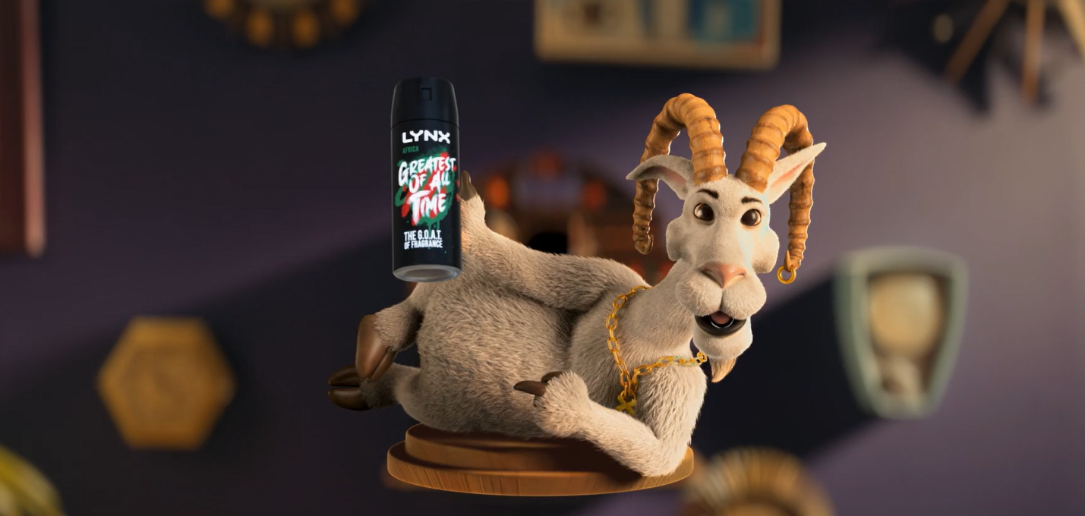
Lynx
The Greatest Of All Time
Sector | Target Audience | Package | Media Agency | Copy Length
FMCG | 16-34s | 16-34 Men AGP + Film Packs | Mindshare | 30”
Background
Lynx was on a mission to win over a new generation of men and ensure its iconic Africa fragrance remains relevant and appealing. The campaign's central message was Lynx Africa declaring itself 'The GOAT' aka the greatest of all time, and the ad itself took a playful and literal approach to claiming its GOAT status, with an animated goat taking centre stage.
Lynx knew cinema delivered strongly for its core younger adult audience and would offer both high attention to the ad and premium associations too - ideal for the launch of the GOAT creative. The campaign ran across key titles for young male demographic including Mission: Impossible - Dead Reckoning Part One, The Flash, Oppenheimer and Indiana Jones and the Dial of Destiny.
Cinema ran as part of a wider campaign that included TV, BVOD, Social, Online and Outdoor.
Key Perception Results
Results
Starting with cinema as part of the media mix at campaign launch worked effectively for Lynx, with cinema helping to drive core campaign KPIs:
Awareness and consideration are both very high: 8 in 10 test cinemagoers are aware of and likely to consider buying Lynx
70% of test cinemagoers recalled seeing the ad, 6% higher than Control and 40% higher than Differentology’s cinema recall benchmark
Over half of those exposed to the ad in cinema agreed it had left them with a ‘better impression’ of Lynx, +13% uplift vs. control.
Test cinemagoers are 11% more likely to agree ‘Lynx is known for having the best fragrances’ and 14% more likely to recommend the brand
+6% uplift
+10% uplift
+10% uplift
Source: DCM / Lynx Conducted by; Differentology, June 2023
Results base: 16-34s. Uplifts are test (exposed to ad in cinema) vs control (not exposed to ad in cinema)

