Slide 1
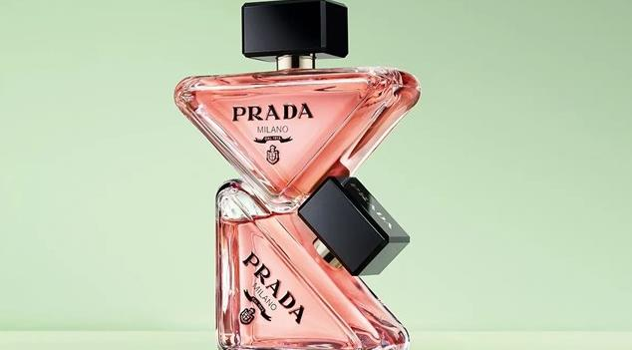
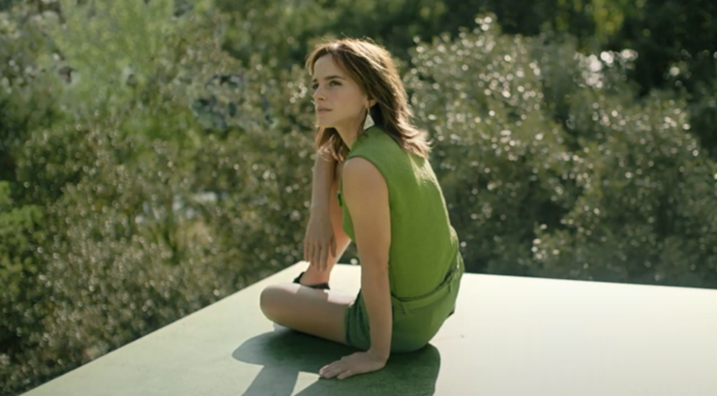
L’OREAL
Prada Paradoxe
Sector | Target Audiences | Package | Media Agency | Copy Length
Cosmetics & Personal Care | Women | 16-34 Women AGP & Bronze Spot (Don’t Worry Darling) | Essence | 60”
Background
Prada Paradoxe was the first major scent for women from the Italian fashion brand to be launched by L’Oréal. Billed as Prada's new signature feminine fragrance, L'Oreal wanted to ensure the launch campaign reflected the stature and prestige of the product.
With a film - capturing “the essence of the undefinable and ever-evolving Prada woman” - fronted by actress Emma Watson, L'Oréal wanted to showcase this in big impactful environments and reach as many potential buyers/gifters as possible, ultimately driving awareness and buzz about the fragrance.
Cinema was therefore a great fit for the brand, with the campaign film running in titles that would efficiently deliver against a female audience including the Bronze Spot in Don’t Worry Darling and 16-34 women AGP titles including Elvis, Where the Crawdads Sing, Ticket to Paradise and The Woman King.
Results
Using the high-impact environment of cinema worked effectively as part of the Prada Paradoxe campaign, with exposure to the ad in cinema leading to significant uplifts in awareness, perceptions, consideration and intention to act.
      Awareness of Prada Paradoxe – 45% uplift
      Advertising Awareness – 50% uplift
      Prada Paradoxe has a classic luxury look and feel – 12% uplift
      Prada Paradoxe is sophisticated and aspirational - 36% uplift
      Likely to consider buying Prada Paradoxe - 28% uplift
      91% of those who expect to buy fragrance in the next three months will take some form of action (e.g. test the Prada fragrance in-store, visit the Prada website)
Source: DCM / L'Oréal Prada Paradoxe. Conducted by; Differentology, September 2022.
Results base: Females 16-34. Uplifts are test (exposed to ad in cinema) vs control (not exposed to ad in cinema)

