Slide 1
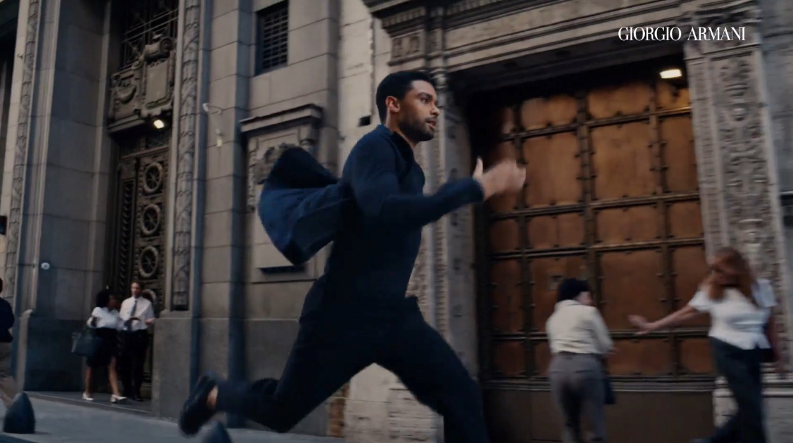
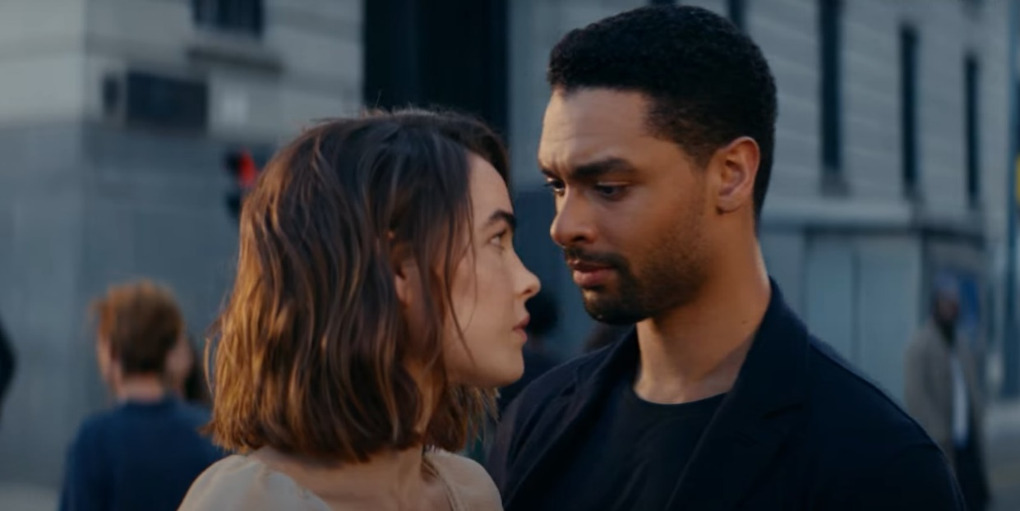
L’OREAL
Armani Code
Sector | Target Audiences | Package | Media Agency | Copy Length
Cosmetics & Personal Care | Primary: Men Secondary: Female gifters | Bronze Spot (Amsterdam) Silver Spot (The Banshees of Inisherin) | Essence | 60”
Background
In the lead up to the key festive purchasing season, L'Oréal wanted to reach those who were in the market for a male fragrance, whether it be for themselves or as a gift to their family or friends. The Armani Code campaign was looking to cut through, excite and engage existing and potential new customers.
The new brand asset starring Regé-Jean Page ran in cinema as part of a wider AV campaign that included TV, BVOD, Social and Online. Cinema was included on the plan as L'Oréal knew that cinema could deliver a young, affluent-skewing audience in a highly receptive environment where more attention is paid vs. other AV formats.
Aligning with premium content was key and the Armani Code ad ran across the DCM estate running in the Bronze and Silver Spots of titles that would efficiently deliver against the primary male audience including Amsterdam and The Banshees of Inisherin.
Results
Cinema worked effectively as part of the AV mix driving significant uplifts across awareness, key brand perceptions, and consideration (for self-purchase and gifting) for those who saw the ad on the big screen compared to those who hadn’t:
Awareness of Armani Code: +9% uplift
Awareness of Armani Code advertising: +19% uplift
Over half of cinemagoers were able to recall the Armani Code ad: +13% uplift vs. DCM benchmark
Armani Code is ‘a fragrance I would wear every day’ (agree): +39% uplift
Armani Code is ‘a fragrance I would gift for someone’ (agree): +29% uplift
Extremely likely to consider Armani Code: +38% uplift
Source: DCM / L’Oreal Armani Code. Conducted by; Differentology, October 2022.
Results base: All Adults. Uplifts are test (exposed to ad in cinema) vs control (not exposed to ad in cinema)

