Slide 1
LG
A Smart Good Life
Campaign Details
Sector | Target Audiences | Package | Media Agency | Copy Length
Technology | Adults (18+) | Family & ABC1 Ads AGP | PHD | 60” / 30”
Background
LG is a well-established technology brand but the aim of the ‘Smart Good Life’ campaign was to raise the brand’s profile and its offering of quality products for across the home. The campaign was designed to highlight how LG’s products are more accessible than ever and most importantly communicate how their lives can be enriched by LG’s technology.
The hero family starring in the ad are there to showcase the positive changes that consumers experience with LG’s innovations. The ad features the family using various LG products (including InstaView refrigerators, TurboWash washing machines, laptops and noise-cancelling earbuds) while they perform a re-worked version of the iconic ‘It’s A Hard Knock Life’ from 1976 musical ‘Annie’ - with the tag line 'It’s a Smart Good Life’.
Plan
LG wanted to ensure the campaign was playing out in an environment where the audience was engaged – and cinema provided the right platform to showcase both the full 60” ad and a shorter 30” cutdown. Alongside the highly attentive audience, cinema’s perception as a premium channel also lent itself to one of the campaign’s key objectives of increasing the brand’s premium reputation.
Running alongside a broader AV campaign (TV, BVOD, Social, YouTube) LG bought a ABC1 Adults and Family AGP with the campaign running in reel across films including The Addams Family 2, Venom: Let There Be Carnage, Dune, The French Dispatch and Ron’s Gone Wrong.

Slide 2
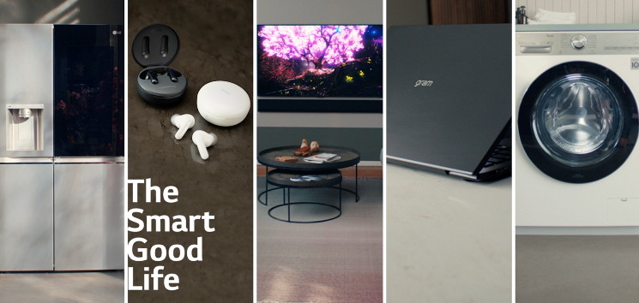
lg
A Smart Good Life
+16% Uplift
+18% Uplift
+11% Uplift
+6% Uplift
58%
of cinemagoers
recalled seeing the ‘Smart Good Life’ ad
(vs. 44% benchmark)
Summary
Increase brand and advertising awareness:
Cinemagoers exposed to the ad on the big screen were 6% more aware of LG and 16% more likely to be aware of recent LG advertising than control (who didn’t see the ad in cinema).
Cinema worked well for LG helping ensure the campaign cut through, delivered positive shifts on key brand perceptions relating to trust, premium quality and innovation. Exposure to the ad in cinema also ultimately increased consideration of the brand and featured hero products too.
Driving key brand perceptions further:
Cinema exposed respondents were 12% more likely to agree ‘LG are an innovative brand’ and 38% more likely to agree that ‘LG make a wide range of products’ vs. control.
Positive impact on consideration:
Cinemagoers are 81% more likely to be ‘extremely likely’ to consider LG vs control (29% vs 16%) and seeing the ad in cinema has also driven consideration of the hero products featured including a LG fridge/freezer (+4%), washing machine (+11%), laptop (+35%) and headphones (+26%).
Source: DCM / LG
Conducted by: Differentology, Oct 2021
Base: 18-54 adults

