Slide 1
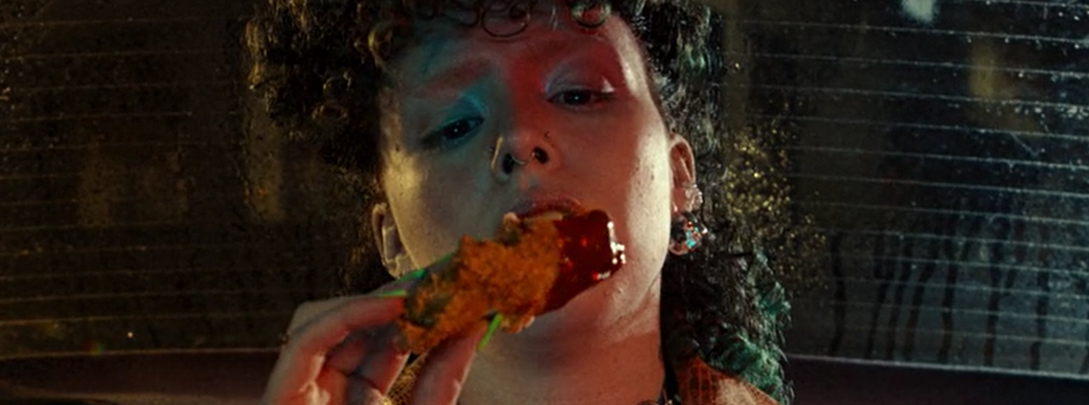
kfc
Sector | Target Audience | Package | Media Agency | Copy Length
FMCG | 16-34s | HFSS AGP + Film Packs | Mindshare | 30”
It’s Finger Lickin’ Good
Background
KFC wanted to stand out in the industry against their competitors as the number one place to get great tasting chicken amongst their target audience of young adults. They knew that to engage with 16-34s, they had to showcase their new 30” creative across a premium visual environment to drive taste credentials with an engaged audience. Whilst KFC is an already established brand, this campaign aimed to drive further brand awareness in addition to boosting consideration of purchasing KFC products.
Plan
Knowing that cinema would be beneficial to help launch this creative, KFC bought into an HFSS AGP in addition to several film packs from running from 12th June - 3rd September, giving them access to films such as Strays, Mission Impossible Dead Reckoning Part One, The Flash, Asteroid City, Oppenheimer and Indiana Jones and the Dial of Destiny.
The cinema activity ran alongside a wider campaign of TV, BVOD, Social, Online and Outdoor where they showcased their 10” copy in addition to skins across online.
Results
Overall, KFC benefitted from accessing the premium and engaging environment of cinema that was successful in delivering significant uplifts across KFCs core metrics including:
+15% uplift in association with being diverse and inclusive
60% aware of the KFC ad
64% recalled seeing the campaign previously, exceeding benchmarks
+60% uplift in having a ‘better impression’ of KFC
+159% uplift in extremely likely to consider KFC for young adults
91% had taken some form of action after watching the KFC ad
+11% uplift
+30% uplift
+20% uplift
Source: DCM / KFC. Conducted by; Differentology, June 2023
Results base: All Ads. Uplifts are test (exposed to ad in cinema) vs control (not exposed to ad in cinema)

