Slide 1

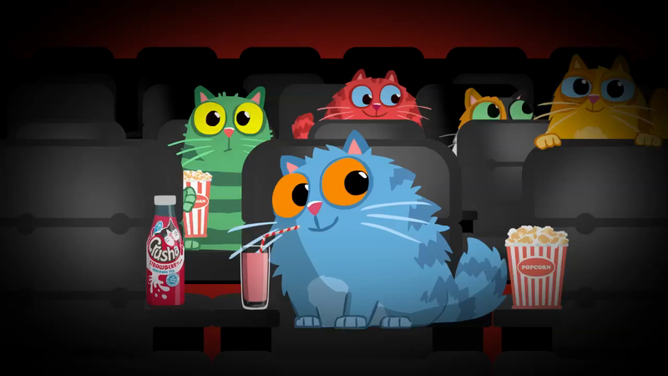
KFC
Imitators
Background
KFC had launched “Chicken Town”, a new 60” TV ad which centred on KFC’s pretenders that litter high streets up and down the country, and the fact that though they try, the reality is this legion of imitators can never match the iconic taste of KFC.
DCM was approached to see how cinema, beyond just using the existing impactful creative, could further engage KFC’s target audience in a distinctive way that would help further drive perceptions of quality and drive consideration.
Extending the narrative of the existing creative, DCM Studios identified an opportunity for KFC to develop a campaign that contextualized itself to upcoming major cinema releases, and help drive customers into restaurants by using DCM’s end-frame technology.
Plan
The content series was inspired by, and run alongside the most highly anticipated Hollywood films launching in 2019, including Godzilla: King Of The Monsters, Spiderman Far From Home, Once Upon a Time in Hollywood, Joker, and Last Christmas
Each piece of content further enhanced the campaign strategy by tricking audiences into thinking the film was about to start, mimicking the look and feel of the upcoming feature, before revealing that they were watching a tongue-in-cheek imitation…and that the real thing was always better
Cinemapper, DCM’s cinema proximity & end-frame planning tool was used to help bring a localised message to this national campaign. By identifying which KFC site was closest to the cinema, DCM could then add a bespoke end frame to the ad, directing cinemagoers to where they could find “the real thing” at their nearest KFC restaurant.
Campaign Details
Sector | Entertainment & Leisure
Target Audience | 18-44s
Package | Gold & Silver Spots
Media Agency | Blue 449
Creative | DCM Studios & Recipe

Slide 2

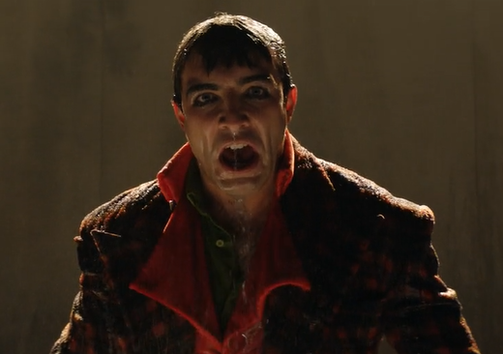
KFC
Imitators
+62% Uplift
+42% Uplift
+24% Uplift
+15% Uplift
Cinemagoers enjoyed the bespoke cinema ads:
Cinemagoers were positive about the creation of contextual advertising; 8 in 10 ‘liked the fact KFC linked its advert to the film they were about to see’, referring to the content as ‘clever’, ‘humorous’ and ‘relevant to their cinema experience’
Summary
Working in collaboration with DCM Studios, KFC created a innovative way of extending its existing campaign to the cinema, landing the key messages around trust and imitators in a fun, contextually-relevant way. The campaign was not only a creative success but also drove significant gains in awareness, impression of the KFC brand and ultimately consideration too.
Improved brand perceptions:
Exposure to the KFC cinema campaign helped drive key perceptions of the brand with cinemagoers more likely to agree that KFC is a modern and trustworthy brand
Significant uplift in consideration:
Consideration was positively impacted by the campaign with Test cinemagoers significantly more likely to consider KFC when next wanting to eat fast food
Source: DCM/Differentology research
Base: 16-44 Adults

