Slide 1
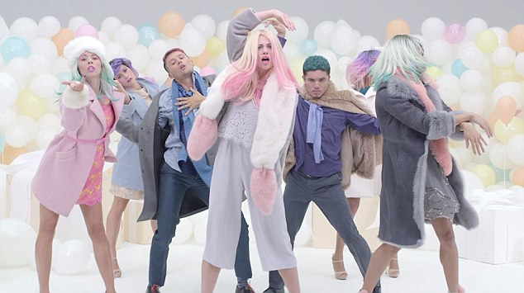
HOUSE OF FRASER
‘Your Christmas, Your Rules’
Background
Numerous department stores have been drawn towards emotional territory in their advertising in recent years and with perception of differentiation between the stores at an all-time low, House of Fraser marked 2015 as the year for change.
2014’s campaign had been a strong success for the business driving sales so the bar had been set high for 2015’s festive activity which needed to drive consideration, differentiation and ultimately sales.
Idea
Christmas is considered to be life’s sixth most stressful event, behind getting married and ahead of being burgled. ‘Your Christmas, Your Rules’ became House of Fraser’s campaign message, encouraging consumers to claim back Christmas and do it on their own terms.
House of Fraser was also keen to differentiate itself from the likely heart-string tugging that other department stores would be doing across the festive period and so its key strategic pillars for the campaign were:
Miss the early November rush and instead focus on maximising share of voice and aligning with different customers’ shopping habits
Be bold and turn heads by taking some eye-catching risks
Upweight channels that provide positive, uplifting environments
Campaign Details
Sector | Retail
Target Audience | Mass Reach
Package | AGP + Film Packs (Star Wars: The Force Awakens & The Hunger Games: Mockingjay)
Creative Agency | 18 Feet & Rising
Media Agency | Goodstuff Communications
Duration | 6 Weeks
Case Study: DCM awards entry July 2015 – July 2016

Slide 2
HOUSE OF FRASER
‘Your Christmas, Your Rules’
Implementation
Alongside a multimedia campaign (including TV, press, OOH and digital display), House of Fraser recognised cinema’s strengths against its three key strategic pillars -
The cinema launch could align with the late integrated campaign launch date (two weeks after the competition) in an environment seldom used by department stores.
The cinema environment would be the most impactful way to showcase the striking ‘Your Christmas, Your Rules’ creative.
Occupying the uplifting cinema environment and buying into the season’s biggest blockbusters would ensure an air of positivity surrounded the campaign message.
With these in mind House of Fraser signed off its first ever cinema campaign, investing heavily into an AGP, as well as buying into The Hunger Games: Mockingjay - Part 2.
Somewhat stereotypically, House of Fraser’s shopping data showed that male customers were more likely to be late Christmas shoppers. Star Wars: The Force Awakens (released on 16th December) therefore represented a great opportunity to reach a male audience at the perfect time.
Due to the strength of the ad’s song, You Don’t Own Me by Grace, the ad was also made Shazam-able. Cinemagoers Shazam-ing the track from their seats would find a House of Fraser takeover where they were able to shop the products featured in the ad.
Results
House of Fraser rewrote the Christmas script to beat the competition to Christmas number one. Year-on-year sales in the six weeks running up to Christmas increased by 5.3% - growing more than John Lewis, Debenhams, M&S and Next.
Spontaneous awareness and consideration increased to 41% and 45% respectively, both coming in ahead of targets set by House of Fraser.
House of Fraser was the only department store to use cinema at Christmas and its role in the success of the campaign was unquestionable.
House of Fraser’s 100% share of voice in the engaging cinema environment translated in to campaign recognition being 6% higher among cinemagoers.
Econometric analysis also revealed that cinema achieved a profit ROI higher than that of Digital Display, National Press and OOH.
Testimonial
“Seeing our ad on the big screen was the highlight of my Christmas. A risk worth taking!”
Stephen Entwistle, Marketing Manager, House of Fraser”
Case Study: DCM awards entry July 2015 – July 2016

