Slide 1
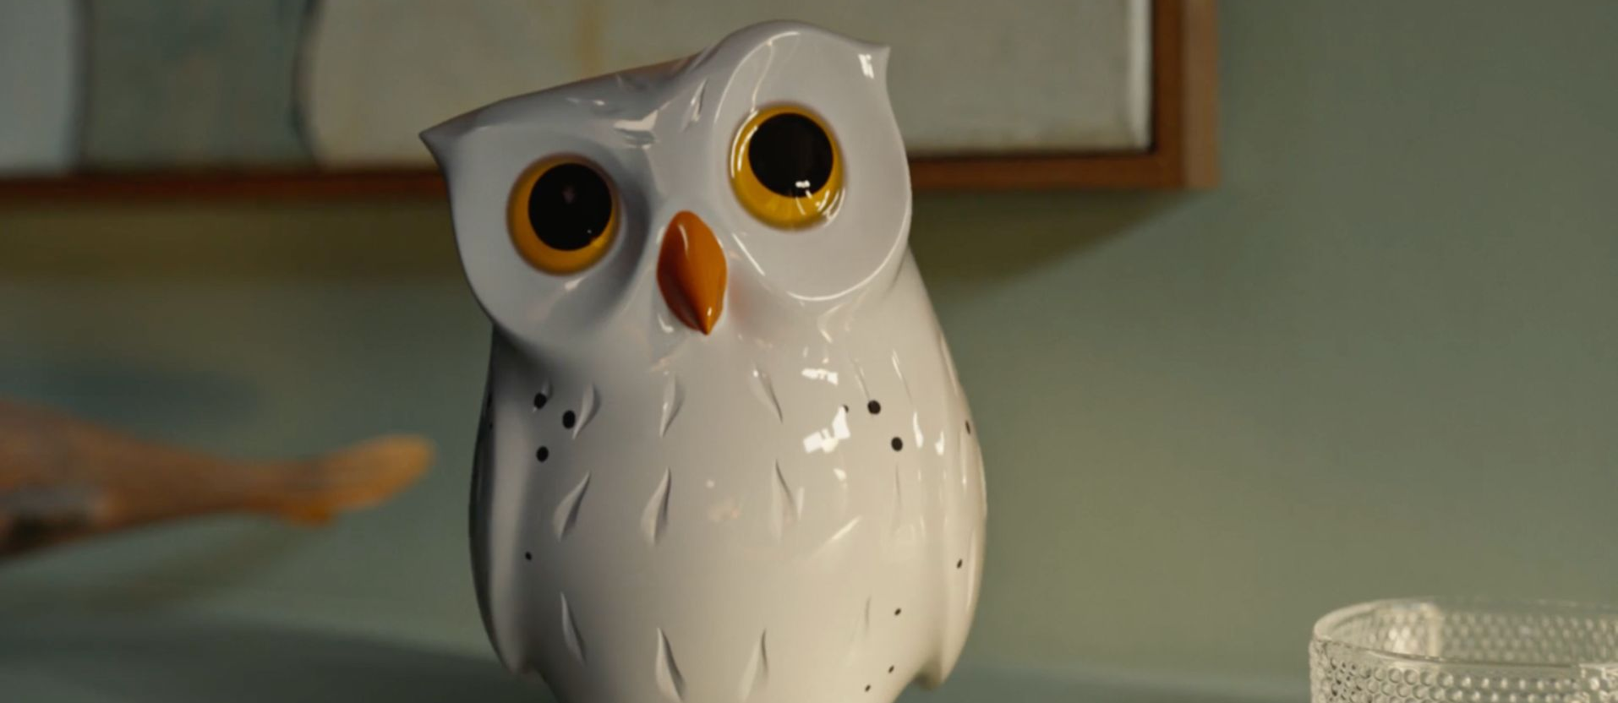
Hillarys
‘For the Window Wise’ click here to visit the website.
Results
Exposure to the ad in the cinema has significantly enhanced Hillarys’ KPI’s, including increasing awareness, perceptions and driving conversion metrics, in turn boosting overall consideration and ultimately leading to sales of Hillarys blinds.
Sector | Target Audience | Package | Media Agency | Copy Length
Retail | ABC1 Women | Prem AGP & Film Pack | EssenceMediacom | 30”
Background & Plan
Hillarys, the UK’s leading supplier and manufacturer of bespoke window dressings, launched an innovative brand campaign to highlight the importance of expert advice and service when it comes to window dressing
The creative copy follows the story of a delightful owl character, whimsically guiding viewers to the benefits of tailored expertise. Voiced by Jennifer Saunders, the campaign was set to charm audiences across various media platforms.
In an effort to extend & maximise incremental reach during the campaign, Hillarys leveraged the power of cinema to enhance attention and engagement. The brand wanted to feature alongside films that aligned with their target audience as well as attracting new audiences to the brand who in the past might’ve disregarded the in-home service. Hillarys bought into a Premium AGP across Feb – Mar 24, giving them access to films such as Bob Marley: One Love, The Iron Claw & Wicked Little Letters, in addition to a film pack in Dune: Part 2, a film that was predominantly ABC1 (c.70%)
+21%
The cinema campaign saw a significant uplift from control to test in being aware of the ad
+16%
Exposure to the ad in cinema delivered significant uplift in brand performance, with agreement for Hillarys ‘is well known for doing what it does’
+42%
respondents had a significantly better impression of Hillarys after exposure to the ad in the cinema
+41%
Test respondents are significantly more likely to be very/extremely like to consider Hillarys
+45%
Test respondents are significantly more likely to trust Hillarys after exposure to the ad in the cinema.
Hillarys have high quality products
Hillarys is a brand I trust
Hillarys offer a quality service
+30%
+45%
+17%
Source: DCM / Hillarys Conducted by; Differentology Feb 2024.
Uplifts are control (unexposed to ad) vs test (exposed to ad)

