Slide 1
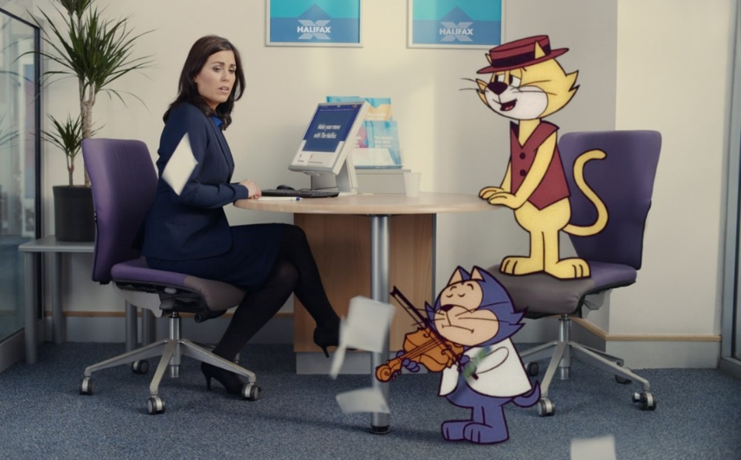
HALIFAX
‘Top Cat’ - 2017
Background
In a competitive sector Halifax prides itself on doing things differently – both in its marketing and how it deals with customers. Halifax wanted to return to its roots of entertaining advertising that engages audiences and brings to life how Halifax staff give ‘extra’ to every single customer, no matter who they are.
Idea
The aim of the new character campaign was to differentiate Halifax from its competitors, demonstrating that whoever visits a Halifax branch they will get the same friendly welcome and excellent service. In this instalment, the classic animated character Top Cat is seen going to Halifax looking for help in buying a new home.
The campaign’s objectives were specifically focused on boosting non-customer awareness and consideration.
Plan
Looking to extend reach among non-customers, cinema was a natural complement to the media mix (television, digital and social) offering Halifax a uniquely engaging environment to showcase its ‘Top Cat’ creative.
The execution used in cinema was a 60” copy which included the TV ad and a ‘bloopers’ reel of outtakes to further land the entertaining nature of the Halifax campaign, to drive preference of the Halifax brand.
Halifax bought an AGP ensuring its ad ran across a range of titles including Logan, Beauty And The Beast, Get Out and Kong: Skull Island.
Campaign Details
Sector | Finance
Target Audience | ABC1 25-54
Package | AGP
Media Agency | Greenhouse GroupM
Creative Agency | adam&eve DDB
Duration | 60”

Slide 2
HALIFAX
‘Top Cat’ - 2017
Results
Uplift in unprompted comms awareness:
Cinema exposed 13% more likely to be aware of Halifax advertising vs. control (no exposure in cinema)
Cinema exposed = 35%, Control = 31%
Summary
Adding to cinema to its AV mix has helped Halifax drive campaign cut through, land key brand perceptions and increase consideration of its service as a mortgage provider among the upmarket cinema-going audience.
Driving key perceptions further:
Those exposed to the cinema activity are 18% more likely to agree Halifax has a ‘reputation for excellent customer service’ vs. control
All agree: Cinema exposed = 65%, Control = 55%
Uplift in consideration:
Those exposed to the cinema activity are 36% more likely to consider Halifax as a mortgage provider vs. control
Top 2 box consideration: Cinema exposed = 19%, Control = 14%
Source: DCM / Halifax
Conducted by; Differentology, March 2017

