Slide 1
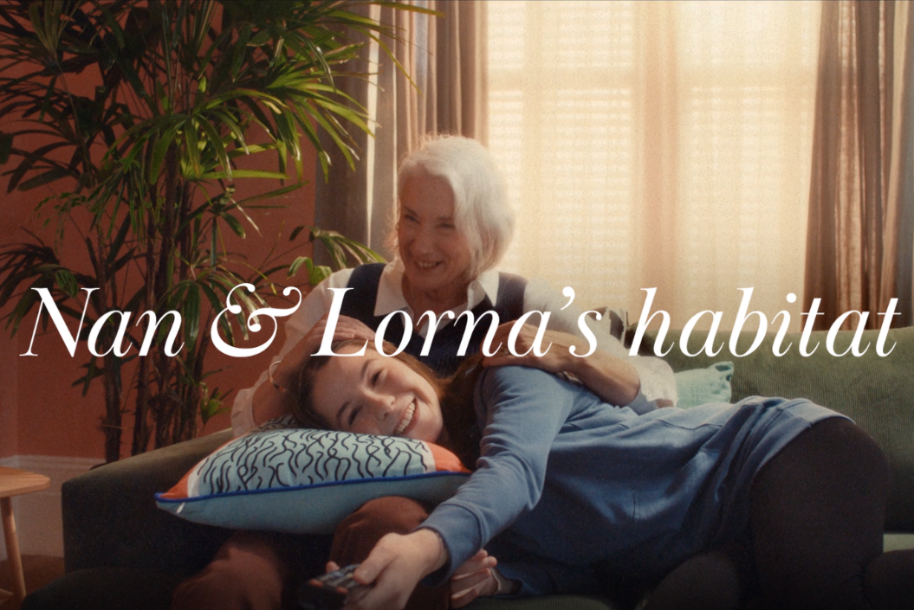
HABITAT
‘Happy Habitat’
Background
The aim of the ‘Happy Habitat’ campaign was to raise the brand’s profile and consideration of its product range.
The campaign looked to inspire customers in the process of updating a whole room or add touches of seasonal style with the breadth of Habitat’s range to create their own personal “habitat”.
This was showcased with products at the centre of the ad showcased in different homes i.e., a bowl for The Gibson's Habitat, a cushion for Nan & Lorna’s Habitat, a roaster for Kian & Jessie’s Habitat etc; highlighting that every household can benefit.
Plan
Habitat wanted to prioritise quality media environments to help build an emotional connection, so cinema was included alongside a broader AV campaign (TV & BVOD).
With a goal to drive impact, capture attention and push likeability amongst the target audience, Habitat selected an ABC1 Adult AGP giving the campaign access to titles including Doctor Strange in the Multiverse of Madness, Top Gun: Maverick and Jurassic World Dominion.
Campaign Details
Sector | Target Audiences | Package | Media Agency | Copy Length
Retail | 25-54s | ABC1 Ads AGP | PHD | 30”
Source: DCM / Habitat. Conducted by; Differentology, June 2022.
Results base: 25-54s. Uplifts are test (exposed to ad in cinema) vs control (not exposed to ad in cinema)

Slide 2
HABITAT
‘Happy Habitat’
+56% Uplift
+33% Uplift
+43% Uplift
+42% Uplift
Summary
Increase awareness & land key messages effectively
Cinemagoers exposed to the ad on the big screen were 23% more aware of recent advertising by the brand and they are 10% more likely to agree that ‘Habitat has a good range of products’ compared to control.
Overall, cinema delivered on Habitat’s key objectives driving positive perceptions, consideration, likeability and brand recall. Exposure to the ad in the cinema ultimately increased core campaign objectives, in addition to driving incremental reach in top of the AV media plan.
Driving key brand perceptions further:
Cinema exposed respondents were 43% more likely to agree ‘Habitat is good value for money’ and 22% more likely to agree ‘Habitat has quality products and great design’ vs. control.
Cinema exposed = 20%, Control = 14%; Cinema exposed = 22%, Control = 18%
Significant uplift in consideration
Just under 60% said they would consider shopping at Habitat – with cinemagoers 42% more likely to be ‘extremely likely’ to consider vs. control.
Source: DCM / Habitat. Conducted by; Differentology, June 2022.
Results base: 25-54s. Uplifts are test (exposed to ad in cinema) vs control (not exposed to ad in cinema)

