Slide 1
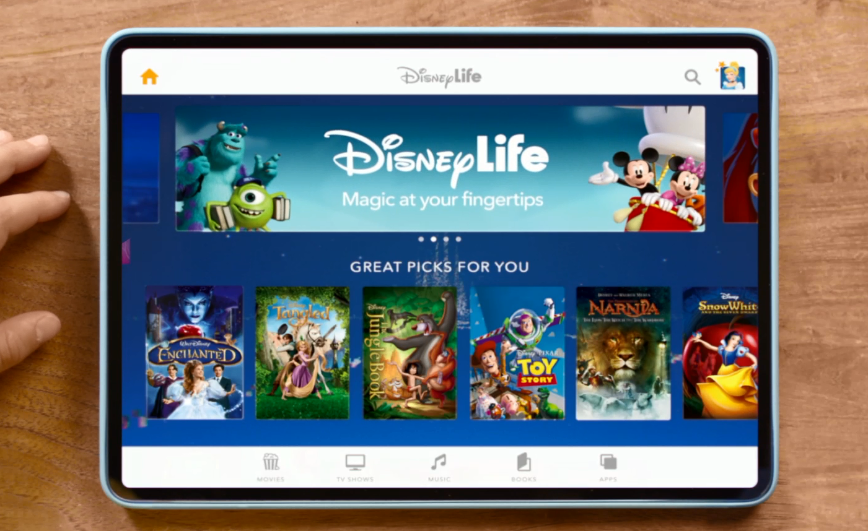
DISNEY
‘Disney Life’ - 2016
Background
At the start of 2016, Disney launched a brand new subscription streaming service, Disney Life. The service provides an “all-in-one experience” combining on-demand access to classic Disney movies and TV shows as well as a library of Disney music, books and games that are regularly updated.
Facing competition from the already established likes of Netflix and Amazon Prime, Disney wanted to highlight the range of well-loved characters and stories that can be watched on the Disney Life.
The core objectives of this campaign was to raise awareness and increase consideration of the Disney Life service amongst the target audience of Mums who have kids aged 2-10 in the household.
Idea
The Disney Life activity was focused on promoting their range of film content, so Cinema was the ideal contextual environment in which to get this message across and drive consideration.
Disney were also interested in understanding the effect of running a campaign in the Gold Spot vs. in-reel advertising. To test this, the Disney Life campaign ran in the Alice Through The Looking Glass Gold Spot, and also in the main ad reel across all other Family films in the same period - including Angry Birds, Top Cat Begins, Teenage Mutant Ninja Turtles: Out Of The Shadows and The Jungle Book.
Campaign Details
Sector | Entertainment
Target Audience | Mums with children aged 2-10 in the household
Package | Gold Spot (Alice Through The Looking Glass) & Family AGP
Creative Agency | Create Advertising
Media Agency | OMD
Duration | May-June 2016
Source: DCM / Disney
Conducted by; Differentology, May 2016

Slide 2
DISNEY
‘Disney Life’ - 2016
Results
Uplift in comms awareness:
Gold Spot Exposed 65% more likely to be aware of Disney Life advertising vs. Family AGP Exposed
Gold Spot Exposed = 33%, Family AGP Exposed = 20%
Uplift in brand awareness:
Gold Spot Exposed 42% more likely to be aware of the Disney Life service
Gold Spot Exposed = 61%, Family AGP Exposed = 43%
Greater message takeout:
Those exposed to the Gold Spot are 12% more likely to agree that ‘Disney Life is the only place you can get all of the best Disney content in one place’ VM vs. Family AGP Exposed
Gold Spot Exposed = 83%, Family AGP Exposed = 74%
Increase in consideration:
Those exposed to Gold Spot activity are 44% more likely to consider Disney Life vs. those exposed to Family AGP activity Gold Spot Exposed = 56%, Family AGP Exposed = 39%
summary
The cinema activity has helped drive awareness, perceptions and consideration of the Disney Life service further among its core target audience of Mums.
The premium Gold Spot position also delivered notable uplifts across all key metrics compared to the in-reel activity, highlighting the value of the advertising in cinema’s most prestigious position.
Source: DCM / Disney
Conducted by; Differentology, May 2016

