Slide 1
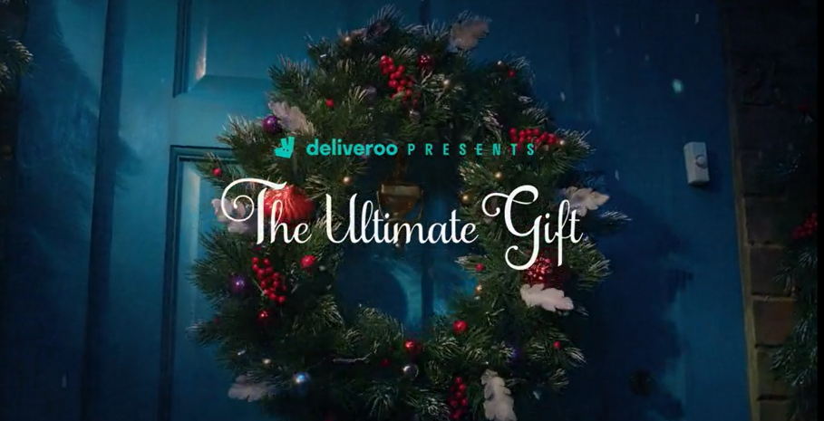
Deliveroo
Nominated at the DCM Awards:
Best Use of Cinema (Large) +
Best Use of Innovation
The Ultimate Gift
Background
Not only does Deliveroo exist in a highly competitive category, in close contention with Just Eat & Uber Eats, Christmas has also always been a threat for food delivery brands each year where consumers food-behaviour routine disappears during the holidays.
With a goal to land what Deliveroo’s role at Christmas can be the key for this campaign was to drive awareness, improve perceptions and ultimately create an impact that would lead to increased consideration and action.
Plan
Knowing that cinema significantly outperforms other top media channels for attentiveness and can deliver significant impact on brand love and consideration, Deliveroo decided to partner with DCM to dominate share of voice in a high impact, premium channel to reach two core audiences: young professionals and comfortable families.
Cinema ran alongside a wider media campaign with TV, Radio & OOH. Deliveroo also wanted to go beyond a traditional cinema buy and be present across the full customer journey at the cinema to maximise impact.
Deliveroo combined its 30” on-screen spots - running in cherry picked films including Encanto, Spider-Man No Way Home and The Matrix Resurrections - with in foyer digital panels. This primed audiences to Deliveroo prior to seeing the movie and then provided them with a timelier reminder post-film, closer to the point they might be considering a takeaway.
Taking this one step further, Deliveroo worked with Mobsta to leverage mobile re-targeting – targeting devices that had visited the geofenced DCM cinemas, to reinforce the messaging and close the Deliveroo consumer journey, in turn driving post-film takeaway orders.
This holistic cross-platform approach helped create a mini-funnel ecosystem within the cinema activity, to drive awareness through the big-screen, consideration within the foyers and finally to conversion via Mobsta retargeting.
Campaign Details
Sector | Entertainment & Leisure
Target Audience | 16-34 Adults
Package | HFSS AGP + Film Packs
Media Agency | Initiative
Duration | 30”
Source: Deliveroo DCM Awards Entry

Slide 2
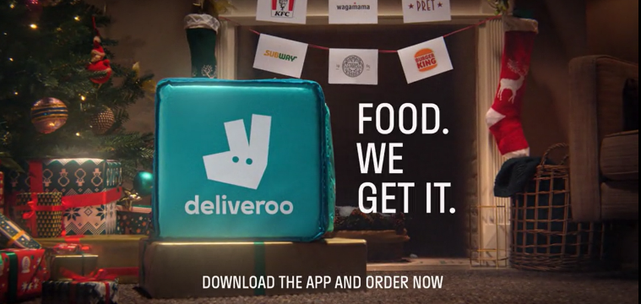
Deliveroo
The Ultimate Gift
Results
+54% uplift
+13% uplift
+80% uplift
Cut through the Christmas clutter:
Those exposed to the ad in cinema were 22% more likely to recall seeing it vs. those who hadn’t been exposed to the campaign at the cinema.
Over 2 in 5 Vue cinemagoers were also able to recall the in-foyer digital screen ads
Mobsta’s research showed that the re-targeting drove additional uplifts in spontaneous (+4%) and prompted (+8%) awareness.
Strengthen Deliveroo’s brand positioning:
The cinema campaign has led to significant increases in key brand perceptions for Deliveroo, including ‘passionate about great food’, ‘offers a wide variety of cuisines’ and ‘is exciting as a gift for Christmas’
Put Deliveroo at the top of everyone’s Christmas list:
Cinema was very effective in boosting consideration of Deliveroo, with over a third of Test respondents claiming that they would be ‘extremely likely’ to consider Deliveroo – 55% uplift from Control.
The cinema activity also worked to drive ‘intention to act’ (+54% vs Control)
Summary
The results highlight how maximising the full cinema experience – foyer, on screen and re-targeting - can deliver on awareness and cut-through of key messages and ultimately have a positive impact on consideration and action too.
Source: Deliveroo DCM Awards Entry, Differentology research

