Slide 1
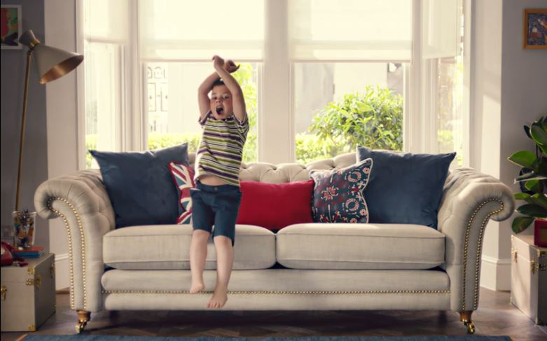
DFS
‘Great Brits’ - 2016
Background
DFS is the dominant player in their category – for many it’s the first place that comes to mind when you want a new sofa. In looking for new growth opportunities, DFS identified a group of consumers who are more aspirational in their purchasing habits – motivated by quality and the origin of the product rather than just price alone.
In the summer of 2016, DFS wanted to further harness its partnership with the Team GB Olympic squad with the aim of changing the long-stand perceptions of the brand, driving reappraisal and improving consideration among this aspirational, older target audience.
Idea
DFS created a brand film that aimed to celebrate the hard work that goes into getting to the ‘top of your craft’. The film intersperse shots of the three Team GB athletes (Laura Trott, Max Whitlock and Adam Peaty) going through their rigorous training regimes and DFS’s own craftspeople hard at work in the Lincoln House Workshop in Derbyshire.
Plan
The ad was aired nationwide on TV throughout August with activity also running on VOD, press, radio and online. During the Olympic Games a series of tactical ads on premium digital OOH sites also ran in the evening before and after each of the featured athlete's finals celebrating their success.
Using cinema to extend the reach of the campaign – knowing that its target audience are lighter TV viewers – the ad featured in the reel across a range of the month’s major titles including Jason Bourne, Finding Dory, The BFG and David Brent: Life on the Road. Buying in to cinema through the broad AGP route allowed DFS to reach its target audience regardless of whether they were visiting with their children or with their partner/friends.
Campaign Details
Sector | Retail
Target Audience | ‘Quality Seekers’
Package | AGP + Family AGP
Media Agency | MediaCom
Creative Agency | Krow
Duration | 30”

Slide 2
DFS
‘Great Brits’ - 2016
Results
Uplift in advertising awareness:
Cinema exposed 30% more likely to be aware of DFS vs. control (no exposure in cinema)
Cinema exposed = 57%, Control = 42%
Uplift in key brand perceptions:
Cinema exposed 36% more likely to agree that DFS sells high quality sofas vs. control
Cinema exposed = 60%, Control = 44%
Uplift in brand relevance:
Cinema exposed 34% more likely to agree that DFS is for ‘people like me’ vs. control
Cinema exposed = 51%, Control = 38%
Increase in top-2 box consideration:
Those exposed to the cinema activity are 63% more likely to consider DFS vs. control
Cinema exposed = 39%, Control = 24%
Summary
Adding cinema to its AV mix has helped DFS drive significant uplifts in campaign awareness, brand perceptions, relevance and consideration of its offering among its core target audience of upmarket, older adults.
Source: DCM / DFS
Conducted by; Differentology, August 2016
Research sample: ABC1 Adults 45+

