Slide 1
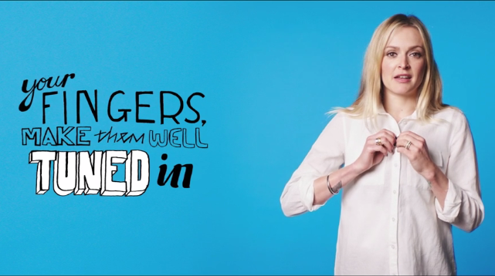
CoppaFeel!
‘#GetItOffYourChest’ - 2016
Background
CoppaFeel! is a health and education charity on a mission to eradicate late detection and misdiagnosis of breast cancer by encouraging women to check their boobs, educating them on the signs and symptoms of breast cancer and empowering them to speak to a GP if they find anything that isn’t normal for them. The aim for 2016 was to build on the strong YoY growth in awareness since the company’s inception in 2009.
Idea
The #GetItOffYourChest campaign aimed to continue the growth in awareness of the lesser known signs and symptoms of breast cancer & give people the confidence to speak to their GP if they find anything that isn’t normal for them. To achieve this, they created a number of assets across various mediums all featuring famous celebrities (Fearne Cotton, Greg James, Russell Kane etc.) promoting the message.
Plan
Looking to extend reach among 16-34 women, female-skewed films in the cinema provided CoppaFeel! with a high-impact environment to showcase their AV copy that was the perfect compliment to the wider media mix (print, radio, OOH & social).
The execution used in cinema was a 60” copy featuring the celebs each saying lines from a poem whilst taking their shirt off to reveal a ‘#GetItOffYourChest’ shirt underneath. The poem was designed to increase symptom awareness, prompt further education by directing viewers to the website and encourage women to overcome their fears of going to the GP.
CoppaFeel! ran in a Female AGP during the opening two weeks of Bridget Jones’s Baby ensuring the ad reached the desired audience. The campaign also ran in other major female releases including Girl On The Train, Bad Moms and Julieta.
Campaign Details
Sector | Charity
Target Audience | 16-34 Women
Package | Female AGP
Media Agency | Mediacom
Creative Agency | Kream
Duration | 60”

Slide 2
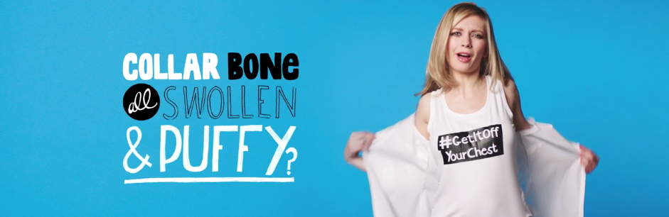
CoppaFeel!
‘#GetItOffYourChest’ - 2016
Results
Uplift in prompted logo recognition:
Cinema contributed significantly to a campaign that delivered a 4% increase in prompted logo recognition year-on-year
2015 = 21%, 2016 = 25%
Summary
Adding cinema to the media mix helped CoppaFeel! bring the campaign story to life and the high impact environment helped land the key campaign messages among their target audience. Cinema helped CoppaFeel! drive brand recognition, campaign cut-through and ultimately awareness of the signs and symptoms of breast cancer.
Uplift in prompted brand awareness:
Cinema contributed towards a 3% increase in brand awareness year-on-year
2015 = 28%, 2016 = 31%
Ad campaign reaction:
70% agree that because of the campaign they understand the signs and symptoms of breast cancer and 74% agree that the campaign stood out
Source: CoppaFeel!

