Slide 1
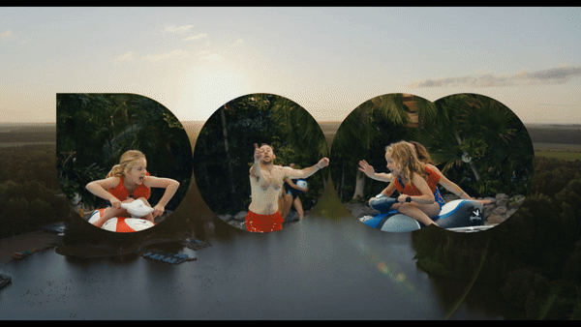

CENTER PARCS
FAMILY SPONSORSHIP

Slide 2
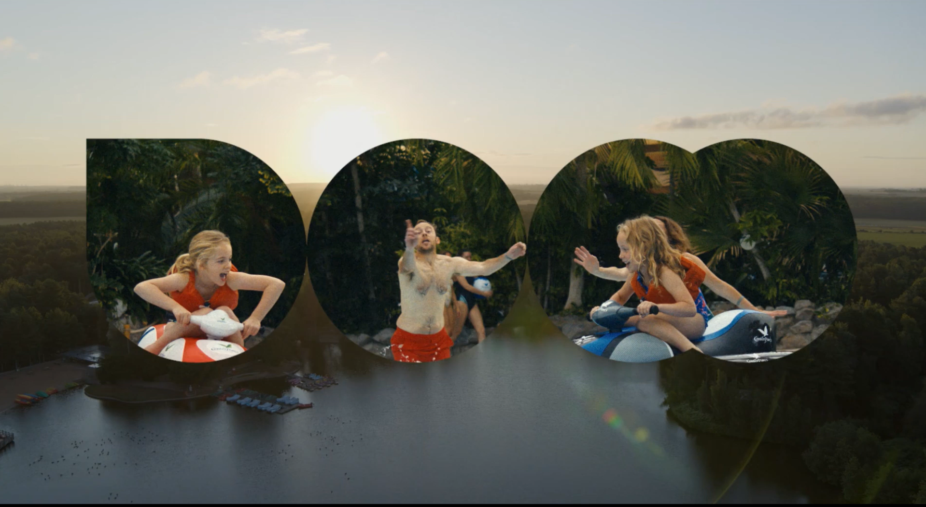

CENTER PARCS
Family Sponsorship
Background
Center Parcs were looking to establish a cinema presence and localise their advertising on screen
Idea
A trip to the cinema is more than just watching a film…it’s an opportunity for families to spend quality time together, escape the routine of everyday life, and immerse themselves in shared experiences.
Recognising the power of this cinema experience, the Center Parcs family sponsorship with DCM Studios engaged their core audience in a meaningful way, aligning their brand with the joy and togetherness that cinema outings inspire.
To bring this vision to life, DCM Studios created bespoke idents featuring co-branded and localised end-frames. These executions seamlessly integrated the Center Parcs messaging with the cinema experience, reinforcing the brand’s commitment to family bonding and relaxation. Through tailored storytelling and the visually engaging content, the idents resonated with audiences on a personal level, strengthening the connection between the brand and its family-focused values.
A key feature of these idents was the use of localised end-frames, which highlighted the nearest Center Parcs location to each cinema where the ad was shown. This approach added a personal touch, making the messaging feel more relevant and immediate to the audience, encouraging them to envision their own family getaway at a destination within easy reach.
Localised end-frames enhance engagement by making the advertising feel tailored to the brand.
>Click to Watch<
Campaign Details
Sector | Leisure | Media Agency | Dentsu
Target Audience | Family | Creative Agency | DCM Studios
Package | Family Sponsorship + Idents | Duration | 1 Year

