Slide 1
CAZOO
The Better Way To Buy Your Next Car
Campaign Details
Sector | Target Audiences | Package | Media Agency | Copy Length
Automotive | ABC1 Adults | ABC1 Ads AGP | Good Stuff | 30”
Background
Launched in 2019, Cazoo is pioneering the shift to online car buying in the UK, selling thousands of cars per month across the country as consumers embrace the ability to buy used cars entirely online.
Cazoo has already achieved significant national brand awareness since launching and the aim of the latest campaign was to continue building the brand into a household name, reinforce value and quality perceptions, and celebrate the convenience of the online buying process.
Plan
Cazoo wanted to invest in cinema for the first time to test the effectiveness of advertising in cinema’s premium environment. Alongside the existing AV plan, cinema was able to add cost-effective incremental cover for its target younger audience too.
Alongside existing media presence on TV, BVOD, social, online, print and radio, Cazoo bought an ABC1 Adults AGP running in reel across a range of films that included The Matrix: Resurrections, The King’s Man, Licorice Pizza, Belfast and Nightmare Alley.

Slide 2
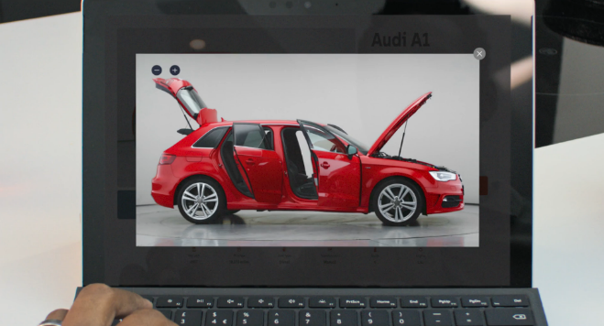
cazoo
The Better Way To Buy Your Next Car
+11% Uplift
+25% Uplift
+17% Uplift
+10% Uplift
60%
of cinemagoers
recalled seeing the Cazoo ad recently
(vs. 50% control)
Summary
Increasing awareness:
Cinemagoers exposed to the ad on the big screen were 11% more aware of Cazoo (vs. control) and exposure to the ad in cinema also delivered an incremental uplift in advertising awareness too (+3%). Recall of the ad was strong too with 60% of cinemagoers recalling seeing the ad recently – 20% increase from control levels (50%) and ahead of the cinema recall benchmark (44%)
Cinema worked well for Cazoo helping the brand drive brand awareness and perceptions of convenience and quality further among the target younger audience, and ultimately made a positive impact on brand consideration too.
Driving key brand perceptions further:
Cinema exposed respondents were 15% more likely to agree ‘Cazoo is a brand for me’ and 55% more likely to agree ‘Cazoo is innovative’ too vs. control.
Cinema exposed = 31%, Control = 27%; Cinema exposed = 34%, Control = 22%
Increasing consideration:
64% of cinema exposed respondents are likely to consider Cazoo when next looking to buy a car – 10% higher than control respondents.
Source: DCM / Cazoo. Conducted by: Differentology, Feb 2022. Base: ABC1 25-34 Adults

