Slide 1
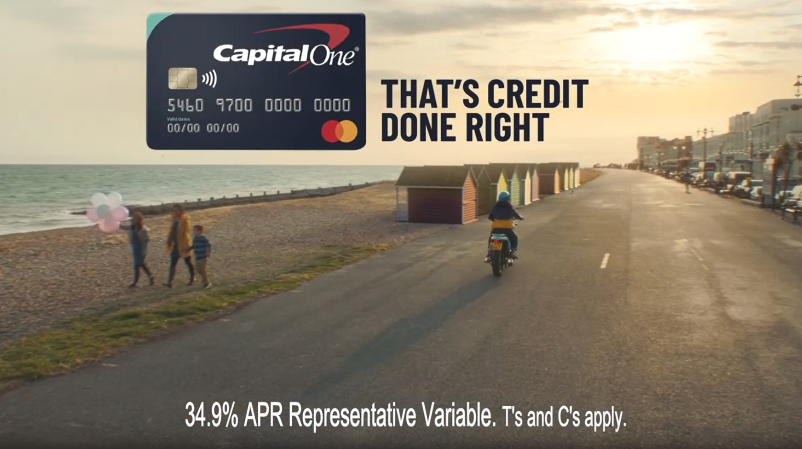
CAPITAL ONE
Credit Done Right
Background
Capital One wanted to leverage its 40” creative in a high impact environment to maximise its impact on key brand metrics and drive cut through of its new ‘that’s credit done right’ positioning.
Cinema was also included on the plan to help drive quality and trustworthiness perceptions of the brand. With research having shown that the audience perception of cinema as a premium environment can transfer to the brands advertising on the big screen, Capital One wanted to harness this to build positive brand perceptions and further consideration.
Plan
With a strong slate of titles releasing in cinemas across the summer, Capital One bought an AGP to maximise reach of its target audience as part of a multi-media mix alongside BVOD, social, online video, outdoor and radio.
Capital One’s ad featured in the reel ahead of titles including Shang Chi And The Legend Of The Ten Rings, Candyman, Free Guy, Jungle Cruise and Space Jam: A New Legacy.
Results
Capital One’s cinema campaign was a success with exposure to the ad on the big screen delivering significant uplifts across a range of metrics and delivering on key campaign objectives:
Awareness of recent advertising: +129% uplift
Capital One are trustworthy: +30% uplift
Capital One ‘do credit the right way’: +32% uplift
Ultimately, those exposed to the campaign in cinema were almost 3x more likely to consider Capital One as their ‘first choice’ for a new credit card than those who didn’t see the campaign in cinema.
Campaign Details
Sector | Finance
Target Audience | 20-54 Adults
Package | AGP
Media Agency | The7Stars
Duration | 40”
Results source: Differentology campaign effectiveness project, September 2021.

