Slide 1
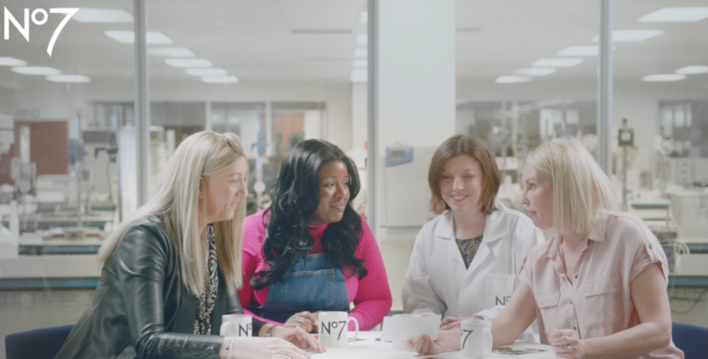
Boots no.7
DCM Awards Nominee
Best Use of Cinema (Large)
Future Renew Range
Sector | Target Audience | Package | Media Agency | Copy Length
Retail | 45+ Women | Female AGP | Essence Mediacom | 170” & 60”
Background
Since its inception, Boots No.7 has been leading the industry as the No.1 brand in the cosmetic category but noticed that growth had been stagnant since 2019 due to competition from the likes of L'Oréal & Olay. No.7 wanted to showcase its new product range whilst staying true to the relatability of the brand.
No7 had a new product range - that reverses the visible signs of skin damage – and needed to showcase the proof behind this big claim but while staying true to the relatability of the brand. The task at hand was to make everyone sit up, take notice, and talk about No.7 as the true market leader again.
Plan
Launching with an unmissable campaign across-media (AV, Print OOH, Social, Digital Audio), No.7 wanted to stand out and elevate the campaign as much as possible, seeing cinema as a space to bring forth its authenticity in a fully immersive and engaged medium.
Capitalising on the power of cinemas long-form opportunity to tell a story, No.7 showcased a 170” short film across a 2-month period, buying into a female AGP that gave them access to an array of films that indexed well for their target audience of 45+ women.
Alongside this a 60” (more product focused) asset was showcased in the Gold Spot of The Unlikely Pilgrimage of Harold Fry – a perfect fit for the target audience - to efficiently elevate the campaign further.
Results
The campaign was a roaring success, with people queuing to purchase the product in-store and the website crashing at launch. Cinema was fundamental in driving these results, helping to secure target audience engagement with the ad and boost key brand metrics.
Awareness and Impressions
Cinema enabled the brand to reach audiences in a positive mindset; this coupled with an emotive ad from No.7 helped the product range really resonate with audiences.
Ad awareness rose by 5% during the time cinema was live.
Sales
Future Renew was the biggest ever product launch for No.7 in terms of revenue generated, with one product sold every two seconds.
No.7 had delivered over 18 weeks of target sales in just the first 25 days of launch
Source: Boots No.7 DCM Awards Entry

