Slide 1
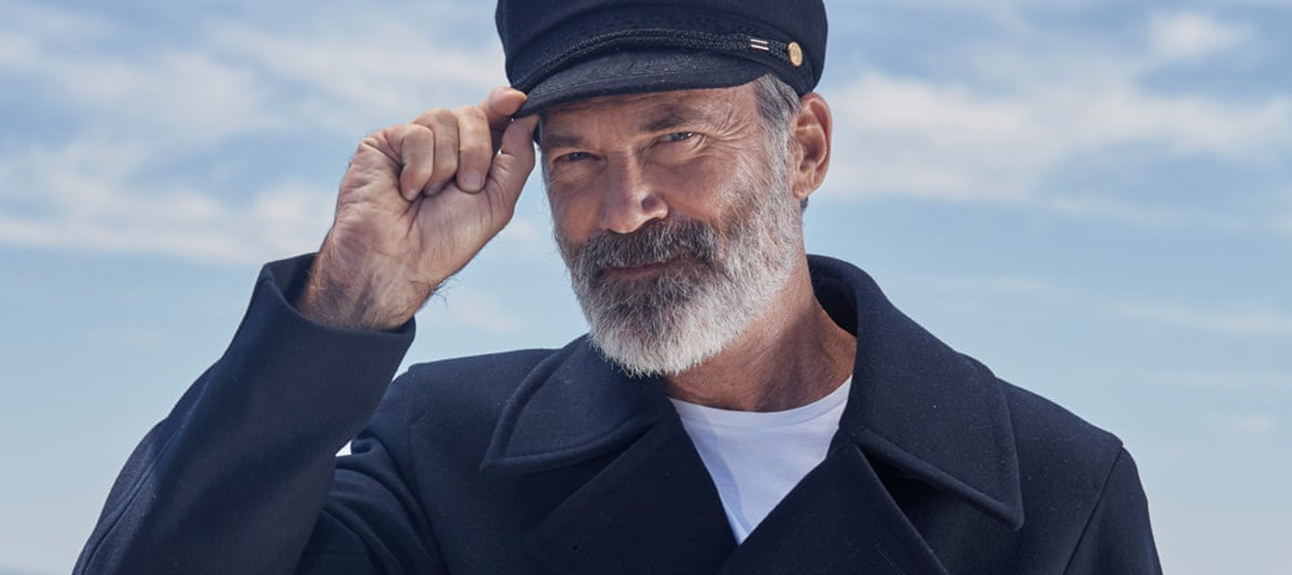
Birds eye
‘Get On Board!’
SECTOR | TARGET AUDIENCE | PACKAGE | MEDIA AGENCY | COPY LENGTH
FMCG | HP+CH | Family AGP | Zenith | 20”
BACKGROUND & PLAN
While already being highly salient, Birds Eye wanted to reach families to promote its new Mini Fish Finger product and saw the opportunity for cinema to drive incremental reach within the AV mix. With a new 20” creative, Birds Eye reintroduced the beloved ‘The Captain’ character to engage audiences, connect emotionally and promote the new product.
Aiming to leverage cinema to enhance perceptions of product quality, sustainability and brand worth, Birds Eye ran in Family AGP titles from April to June including Migration and Kung Fu Panda 4. Alongside cinema, the ad also ran across TV, BVOD, Social Media, YouTube, and content creators.
RESULTS
The inclusion of cinema was successful in improving Birds Eye’s core brand metrics, with the campaign helping to drive significant uplifts across awareness, consideration and purchase intent, with further uplifts also seen across core brand metrics:
RECALL
RECOMMENDATION
IMPROVED IMPRESSION
+24%
+17%
‘Birds Eye provides food which is sourced responsibly’
‘Birds Eye makes me feel reassured that the food I’ve prepared is the best quality’
‘Birds Eye is a brand worth paying more for’
+32%
+27%
+17%
+46%
Source: DCM / Birds Eye Conducted by; Differentology May 2024.
Uplifts are control (not exposed to ad in cinema) vs test (exposed to ad in cinema)

