Slide 1
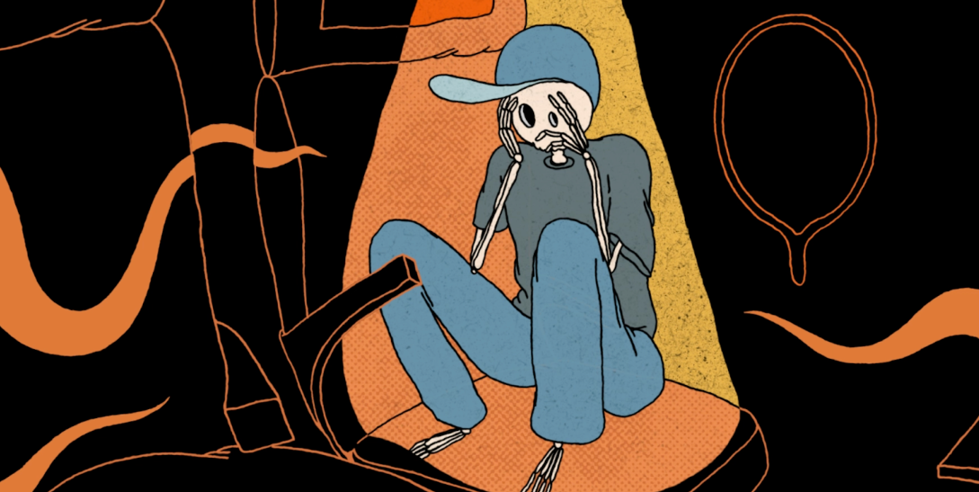
BEAVERTOWN
Sector | Target Audience | Package | Media Agency | Copy Length
Alcohol | 18+ Adults | Gold Spot | Dentsu | 180”
Flightmare: A story of turbulence, tentacles, and terror.
Background & Plan
Beavertown wanted to showcase its 180” creative to an engaged 18+ audience who drink premium beer and saw the benefit of cinema as the perfect platform for longer storytelling and reaching a more affluent audience.
Wanting to build brand associations between Beavertown and Halloween, the 3-minute copy showcases the brewery's visually creative approach. An eccentric animation of ‘Flightmare’, the tale inspired by the mysterious events of the Bermuda Triangle, the ad was to take cinemagoers on a ‘dimension-bending’ trip.
Looking to launch at the start of October, Beavertown bought the Gold Spot in The Exorcist: Believer, a perfect contextual match for the beer brand to associate with a horror genre classic reboot that would draw in audiences in the run up to and on Halloween.
The full 3-minute graphic short film was only planned to run in cinema, with additional shorter 10” - 30” cuts playing out across social, online and outdoor.
Results
Running the long-form animation in the Gold Spot was successful in driving impression metrics for Beavertown, with positive shifts seen across consideration, recommendation and perception metrics:
+45% uplift
+113% uplift
+35% uplift
+50% uplift
Impressions
Impression of the Beavertown brand improved with an +11%
positive uplift
Consideration
Exposure to the ad in cinema delivered a significant +27%
increase in consideration
Recommendation
Brand recommendation also significantly increased by +25%
Associations
Associations of Beavertown with ‘The Halloween Spirit’ significantly increased by +85% after exposure to the ad in cinema
Source: DCM / Beavertown Conducted by; Differentology, Oct 2023.
Results base: 18+ Uplifts are control (unexposed to ad) vs test (exposed to gold spot ad)

