Slide 1
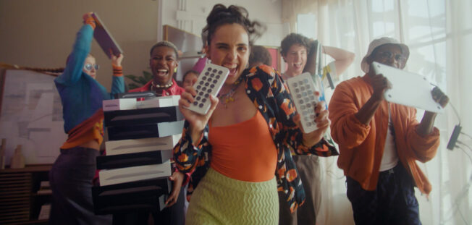
Back market
Sector | Target Audience | Package | Media Agency | Copy Length
Retail | All Adults | Bronze Spot | Wavemaker | 60”
‘The New One’
Background & Plan
Knowing that they were yet to establish themselves against tech retail competitors in their industry, Back Market aimed to build on their brand awareness and overall upper-funnel metrics across a broader audience.
They decided to invest in cinema, seeing it as the perfect platform to reach an engaged and premium audience, to help drive incremental reach on top of their wider campaign that included TV, BVOD, Social, Online, and Outdoor.
Back Market bought a Bronze Spot in The Marvels with their 60” copy from November 2023 – January 2024, which gave them access to a highly attentive and affluent audience.
Results
Back Market benefitted through the use of an engaging and attentive space like cinema to boost their core campaign KPIs, seeing significant uplifts across both upper funnel (overall awareness) and lower funnel (conversion) metrics.
Brand Awareness
Exposure to the ad in the cinema drove a +28% uplift in being aware of Back Market
Associations
Cinema delivered a +55% uplift for a strong association of Back Market with having premium tech.
Perceptions
Cinema delivered a +38% uplift in perception of Back Market being an ‘innovative brand’
Consideration
Consideration of Back Market significantly increased by
+25% when exposed to the ad in cinema
Action
c.20% of Test cinemagoers intend to purchase a product from Back Market as result of this campaign
Source: DCM / Back Market Conducted by; Differentology, Nov 2023.
Results base: 16+, Uplifts are control (unexposed to ad) vs test (exposed to bronze spot ad)

