Slide 1
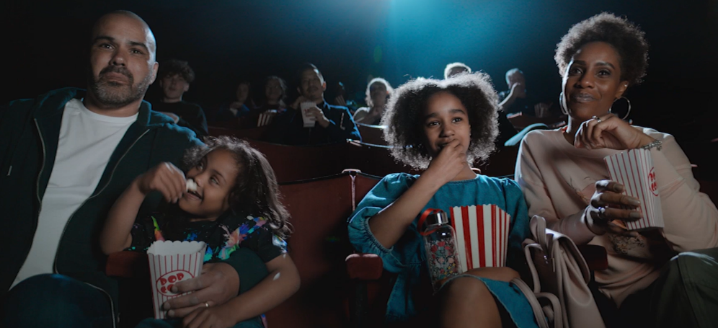
BT
DCM Awards Winner -
Best Use of Cinema (Large)
Unbreakable Broadband
Sector | Target Audience | Package | Media Agency | Copy Length
Telecoms | All Adults | AGP + Silver Spots | Essence | 60”
Background & Plan
When lockdown hit, people had to rely on their home broadband for work, play, wellbeing, home schooling and entertainment. Wi-Fi speed went from a ‘nice to have’ to a ‘daily essential’. Therefore, as the UK emerged from lockdown, BT aimed to attract new customers with a campaign that communicated unbreakable connection.
Having previously worked with the DCM Studios team, BT knew that cinema provided an opportunity to showcase the need for unbreakable broadband in a unique and attention-grabbing way as soon as they re-opened in May 2021.
With inspiration to trick cinema audiences, BT wanted to centre its creative on key moments of cinematic tension, where ‘poor wi-fi’ would be positioned as the real villain. Two bespoke 60” ads were created with footage licenced from Paddington 2 and Tomb Raider. Each ad opens with an iconic scene from the film being watched by an audience in the cinema, when suddenly, the dreaded buffering ‘wheel of death’ appears. An unsatisfied audience shuffle in their seats before relief comes when the buffering ends and the film continues.
A reassuring voiceover states that 88% of UK cinemas depend on BT broadband to bring the films we love to life and if buffering broadband is unacceptable in a cinema, then audiences shouldn’t stand for this at home either.
Results
Exposure to the cinema ad delivered on the campaigns key brand metrics:
Brand recall: 1 in 2 cinemagoers recognised the creative with 47% agreeing it was memorable
Brand impression: 43% of cinemagoers agree it’s important to have a reliable broadband provider
Creative awareness: 50% said the creative grabbed their attention
“Our cinema partnership and strong creative idea drove our message home that quality broadband is a life essential. The cinema campaign outperformed TV in several areas thanks to the captive audience, and central media idea.”
Pete Jeavons, Marketing Communications Director, BT & EE
Source: BT DCM Awards Entry

