Slide 1
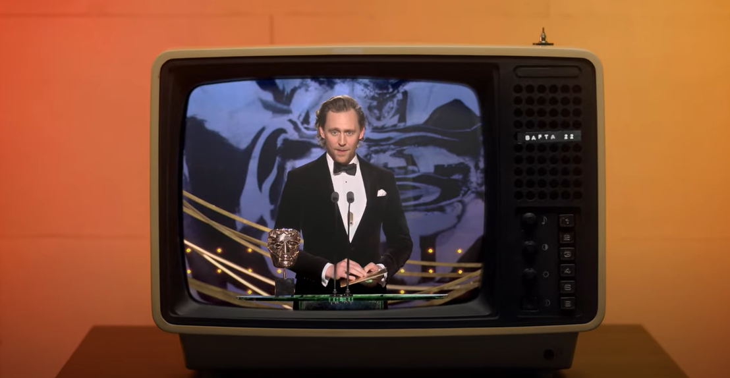
bafta
Behind Every BAFTA
Sector | Target Audiences | Package | Copy Length
Charity | 16-34 Adults | 16-34 AGP | 60”
Background
BAFTA and Digital Cinema Media (DCM) partnered on a cinema campaign designed to inspire and ignite the next generation of creative talent. The ‘Behind Every BAFTA’ ad, produced by DCM Studios and narrated by double BAFTA-award winning Big Zuu, showcased the diverse range of skills and knowledge that goes into making award-winning films, games and television – from writing to wardrobe, coding to camera-rigging, and special effects to sound.
The ad ran across the DCM estate, running in titles that would efficiently deliver against the core 16-34 target including Nope, Bullet Train and Don’t Worry Darling.
Alongside the cinema ad, a supporting careers campaign was led by BAFTA on its social and digital platforms to highlight free resources and guidance provided including mentoring, bursaries, networking opportunities, and career development initiatives, to help people take their first step into the industry.
Results
Results
Overall, the results highlight how seeing the ad in the high attention environment of cinema can deliver key campaign KPIs including awareness, driving positive perceptions and specifically for BAFTA boosting consideration of a career in the screen industries.
      Awareness that BAFTA is a charity: +69% uplift
      Associate BAFTA with games: +88% uplift
      51% agree that BAFTA supports talents from all backgrounds
      ‘Much better’ impression of BAFTA: +32% uplift
      61% agree that the ad highlighted the multiple careers in the film, TV and games industry
      42% agree that the ad inspired me to consider a career in the screen industries
Source: DCM / BAFTA. Conducted by; Differentology, October 2022.
Results base: 16-34s. Uplifts are test (exposed to ad in cinema) vs control (not exposed to ad in cinema)

