Slide 1
audi
Q4 e-tron and e-tron GT
Campaign Details
Sector | Target Audiences | Package | Media Agency | Copy Length
Automotive | ABC1 Adults | Gold Spots | PHD | 3 x 60”
Background
As the automotive industry begins to prepare for the 2030 ban on the sale of new petrol and diesel cars in the UK, Audi wanted to be on the front foot and establish its credentials as a leader in the electric vehicle market.
The aim of the campaign – promoting both the Q4 e-tron and e-tron GT models – was to drive awareness and desire of Audi and ultimately increasing consideration for its electric vehicles.
Plan
Cinema was used alongside a broader AV campaign (TV, BVOD, Social, Online) for its premium association and upmarket audience skew.
With the cinema burst starting just days before Christmas, Audi wanted to maximise relevance and so decided to run three pieces of copy across its two Gold Spot selections – The King’s Man and The Matrix: Resurrections.
The Q4 e-tron ad (starring Rege-Jean Page) was seen by those who went to see The King’s Man; while those who went to see The Matrix: Resurrections in the lead up to Christmas saw the e-tron GT Christmas copy. This was then switched out post-Christmas to the Janelle Monae-starring e-tron GT ad.
Source: DCM / Audi Conducted by: Differentology, Dec 2021. Base: ABC1 Adults

Slide 2
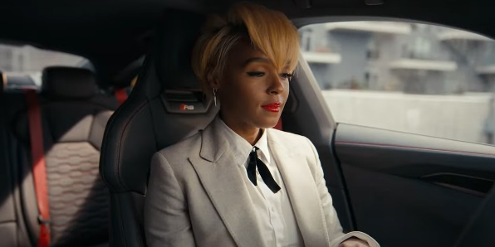
AUDI
Q4 e-tron and e-tron GT
+14% Uplift
+14% Uplift
+12% Uplift
+32% Uplift
66%
of cinemagoers
recalled seeing the ‘Q4 e-tron’ ad
(vs. 44% benchmark)
Summary
Increasing model and advertising awareness:
Cinema helped deliver increases in awareness for both models featured across the campaign, with an average uplift of 14% vs control. The cinema exposed group were also significantly more likely to be aware of recent advertising for both the Q4 e-tron and e-tron GT too.
Using cinema to engage an affluent audience with its range of electric vehicles worked successfully for Audi – with cinema delivering significant increases in model awareness and consideration of its electric vehicles. The cinema campaign also helped create a positive impression and drive perceptions of innovation, excitement and prestige further.
Driving key brand perceptions further:
Cinema exposed respondents were 7% more likely to agree ‘Audi is a prestige brand’ and 10% more likely to agree that ‘Audi stands for beautiful design’ vs. control. Cinema exposed group are also 17% more likely to agree the campaign has left them with a ‘better impression’ of the brand too.
Positive impact on consideration:
Over 80% of cinemagoers are likely to consider Audi – and seeing the ad on the big screen has specifically helped drive top end consideration. Cinema exposed group are 32% more likely than control to be ‘extremely likely’ to consider Audi if they were buying an electric car.
Source: DCM / Audi
Conducted by: Differentology, Dec 2021. Base: ABC1 Adults

