Slide 1
ARGOS
Christmas Is On
Campaign Details
Sector | Target Audiences | Package | Media Agency | Copy Length
Retail | Adults Young Families | Family & ABC1 Ads AGP | PHD | 60”
Background
For almost 50 years Argos has been a festive staple – whether it be circling the catalogue or browsing the website – it has been a source of inspiration and helped many Christmas shoppers get ready for the big day. After a disrupted Christmas in 2020, the brand wanted to focus on helping its customers have the best Christmas yet with gifts that their family and friends will love.
The ‘Baubles to Last Year, Christmas is On!’ ad showcases the pure jubilation of Christmas and all the ways families across the country can celebrate together – whether you’re the neighbour who’s always first to put decorations up, the person at work who starts wearing a Christmas jumper in October or those who impatiently for the delivery man to arrive with those special gifts for loved ones.
Plan
Appealing to Christmas enthusiasts across the UK, Argos wanted the campaign to reach as many shoppers and families as possible so planned a broad media mix that included TV, BVOD/Online video, social, outdoor and press.
Cinema was added to the mix to help diversify the AV campaign and with a strong family profile was particularly key in broadening reach amongst the key audience in the run up to Christmas during an occasion of parent/child co-viewing.
Running from mid-November to Christmas Eve in cinemas, Argos bought a ABC1 Adults and Family AGP running in reel across a range of films including Encanto, Ghostbusters: Afterlife, House of Gucci, Clifford The Big Red Dog and West Side Story
Source: DCM / Argos Conducted by: Differentology, Dec 2021
Base: 18-54 adults

Slide 2
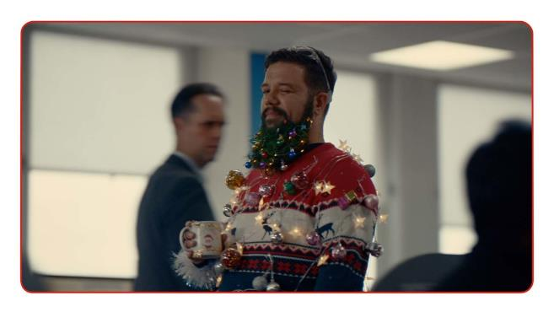
ARGOS
Christmas Is On
+23% Uplift
+17% Uplift
+11% Uplift
+50% Uplift
71%
of cinemagoers
recalled seeing the ‘Christmas Is On’ ad
(vs. 44% benchmark)
Summary
Increase advertising awareness and consideration:
Cinemagoers exposed to the ad on the big screen were 23% more aware of recent advertising by the brand s and almost 9 in 10 said they would consider shopping at Argos – with cinemagoers 50% more likely to be ‘extremely likely’ to consider vs. control.
Adding cinema to the AV mix for the Christmas campaign worked well for Argos – driving cut through, resonance of the brand as a great location for buying gifts and having everything shoppers need and ultimately made a positive brand impression and increased consideration at a key time of the year.
Driving key brand perceptions further:
Cinema exposed respondents were 11% more likely to agree ‘Argos has a great range of products’ and 7% more likely to agree ‘Argos is a great place to buy Christmas gifts’ vs. control.
Cinema exposed = 53%, Control = 39%; Cinema exposed = 49%, Control = 31%
Positive brand impression
64% of cinema exposed respondents agree the campaign has a positive impact on their opinion of Argos and they are 37% more likely to agree that ‘Argos is a retailer I feel close to’ compared to control.
Source: DCM / Argos Conducted by: Differentology, Dec 2021
Base: 18-54 adults

