Slide 1
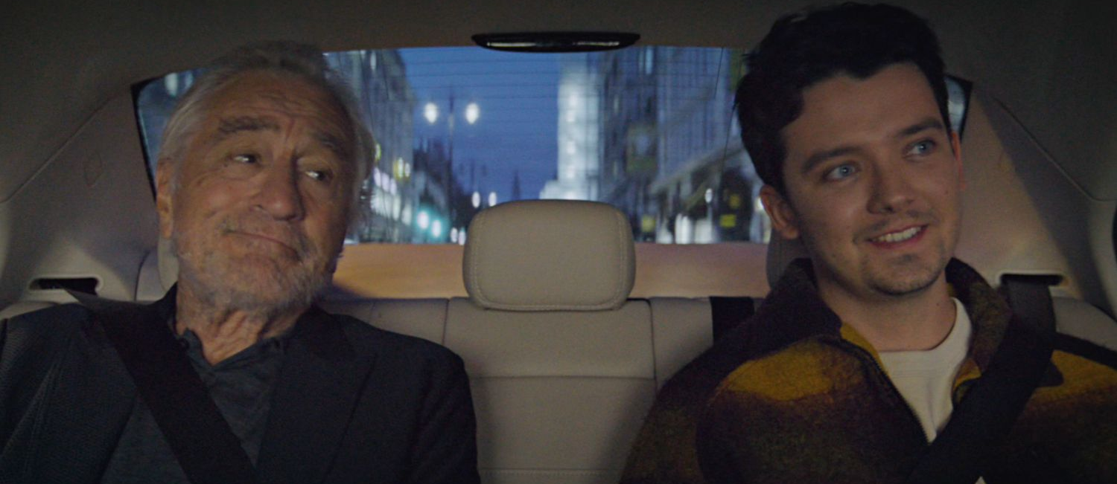
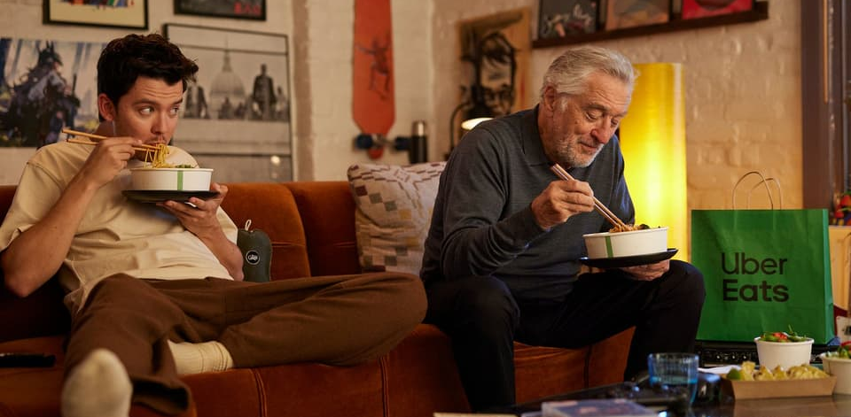
Uber one
SECTOR | TARGET AUDIENCE | PACKAGE | MEDIA AGENCY | COPY LENGTH
Travel | ABC1 Adults | ABC1 AGP | EssenceMediacom | 180”
‘Best Friends’
BACKGROUND
Uber wanted to launch a new subscription service that let people save money across its platform. After a year of building awareness through its owned channels, Uber hit an awareness ceiling, where they found that memberships were flatlining – so they aimed to boost mass reach and awareness, across an upmarket audience to help drive usage.
PLAN
Uber One was created, a paid membership platform that allows members to save money and access benefits across Uber Eats and Uber Rides. In other words, it’s a membership exclusively for people who eat food and go places. Mother created a 3-minute film featuring Hollywood icon Robert De Niro and rising British actor, Asa Butterfield. Throughout the copy, we see them form an unlikely friendship after bonding over their uniquely shared passion for eating food and going places. Wanting to reach an audience who seek out exclusivity and quality whilst tapping into the UK’s obsession with Hollywood stars, Uber One showcased this ad across cinema only buying an ABC1 AGP across London only.
RESULTS
Cinema was successful in engaging Uber One’s target audience, helping to exceed their goals in boosting awareness, whilst also seeing an uplift usage for existing Uber users. Uplifts were seen across the campaign for the below metrics:
AWARENESS
USAGE
RECALL
Source: DCM Awards: Uber One Case Study 2024.

