Slide 1
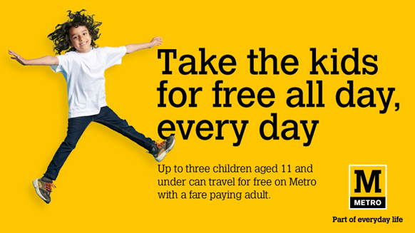
nexus
SECTOR | TARGET AUDIENCE | PACKAGE | MEDIA AGENCY | COPY LENGTH
Travel | Families | Film Packs / Family AGP | EssenceMediacom | 30”
‘Kids Go Free’
BACKGROUND
Nexus, the public transport provider in Tyne and Wear, faced a challenge of getting people out of their cars and on to their Metro trains, particularly families. The goal was not just to boost ridership, but also to contribute to a cleaner, greener community by reducing CO2 emissions, so objectives were set to increase free child journeys, boost adult journeys and contribute to a 50% reduction in carbon emissions in the Newcastle metro area.
PLAN
To ensure it achieved significant exposure to a family audience during the February and Easter holidays when children are out of school and families are spending quality time together, with its 30” copy, Nexus bought into the Ghostbusters: A Frozen Empire film pack in addition to a Family AGP, giving them access to films such as Kung Fu Panda 4 & Migration.
RESULTS
Cinema provided an unparalleled experience that captures the undivided attention of both children and adults. This high level of engagement translated to stronger brand recall and a more significant impact on consumer behaviour, as indicated by the outstanding results of this campaign. The campaign not only met but exceeded the challenging objectives, contributing to a cleaner, greener Tyne and Wear community. The success of this campaign underscores the unique power of cinema as an advertising medium, proving that it can deliver exceptional results that other channels simply cannot match.
+55%
Adult journeys increased by 14% on the previous year – around an additional 50,000 adult journeys.
-66%
+14%
Free child journeys on the Metro increased by 55% on the previous year.
Reduced CO2 emissions by 66% with families choosing the Metro over driving a car.
Source: DCM Awards: Nexus Case Study 2024.

